Slide 1
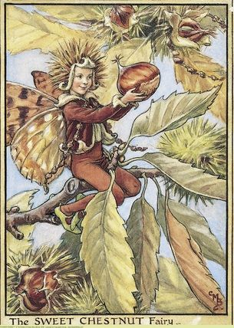
MA/RI 2016 NEWS
September 10, 2016

Slide 2
Research orchards
Tower Hill Botanic Garden, W. Boylston MA
Wrentham Developmental Ctr. Wrentham MA
Land’s Sake, Weston MA
Clark’s, Hawley MA
Moore State Park, Paxton MA
Clark Property, Ashfield & Hawley MA
Chestnut Preserve, Stockbridge MA
Idylbrook Park, Medway MA
Jamie Donald, Lunenburg MA

Slide 3
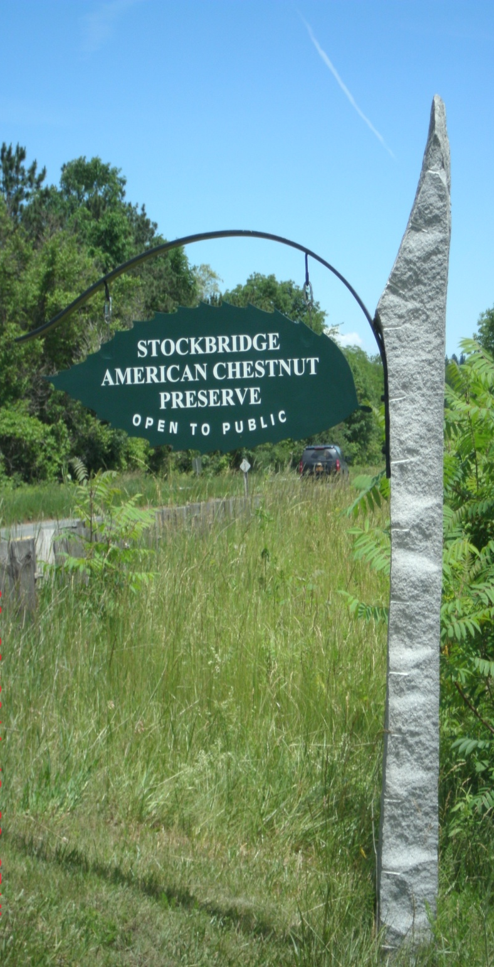
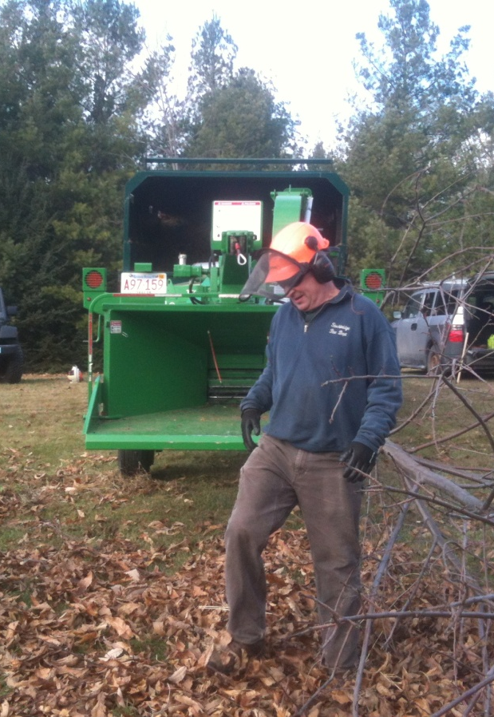

Slide 4
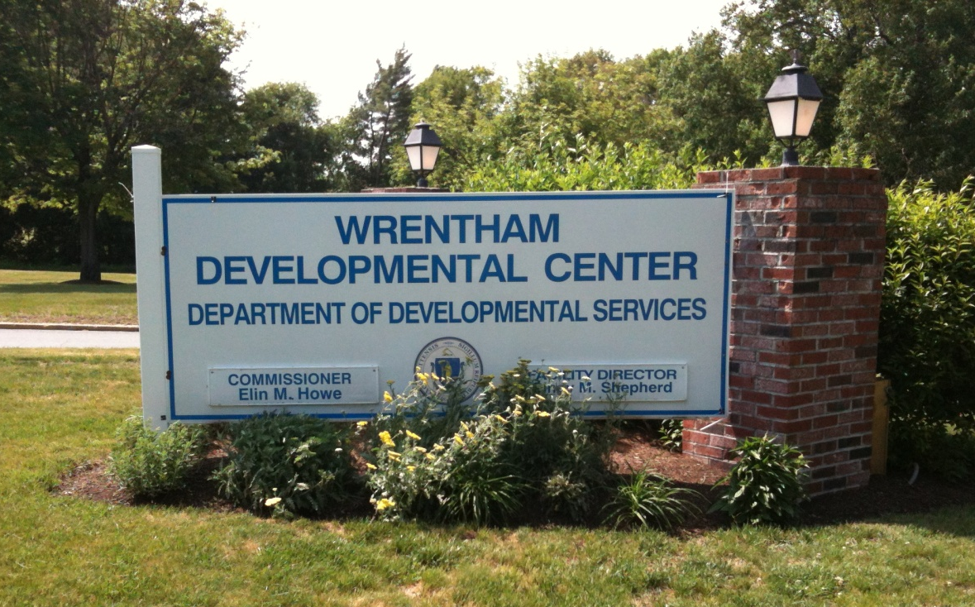
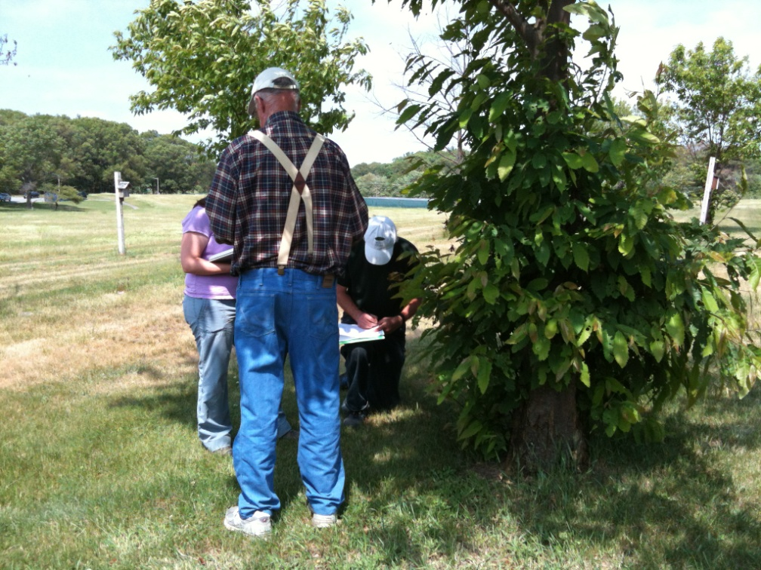
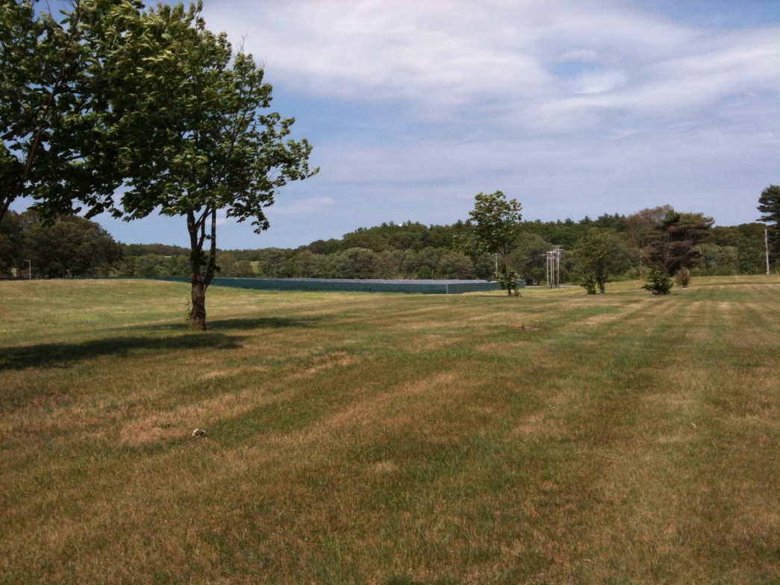
Notes:
Matching people with skills is very important, especially with the nature of the work we are doing. Many times, people would love to volunteer, but don’t want to work outside, can’t do the work we’re asking for, or don’t feel that their skills are being used in ways that are advantageous to us and to them!

Slide 5
Seed orchards
South Kingstown Land Trust, RI
Springside Park, Pittsfield MA
Smith College MacLeish Field Station, Whately MA
Land Sake, Weston MA
MassWildlife, Westborough MA
John & Sarah Meiklejohn Property, Granville MA

Slide 6
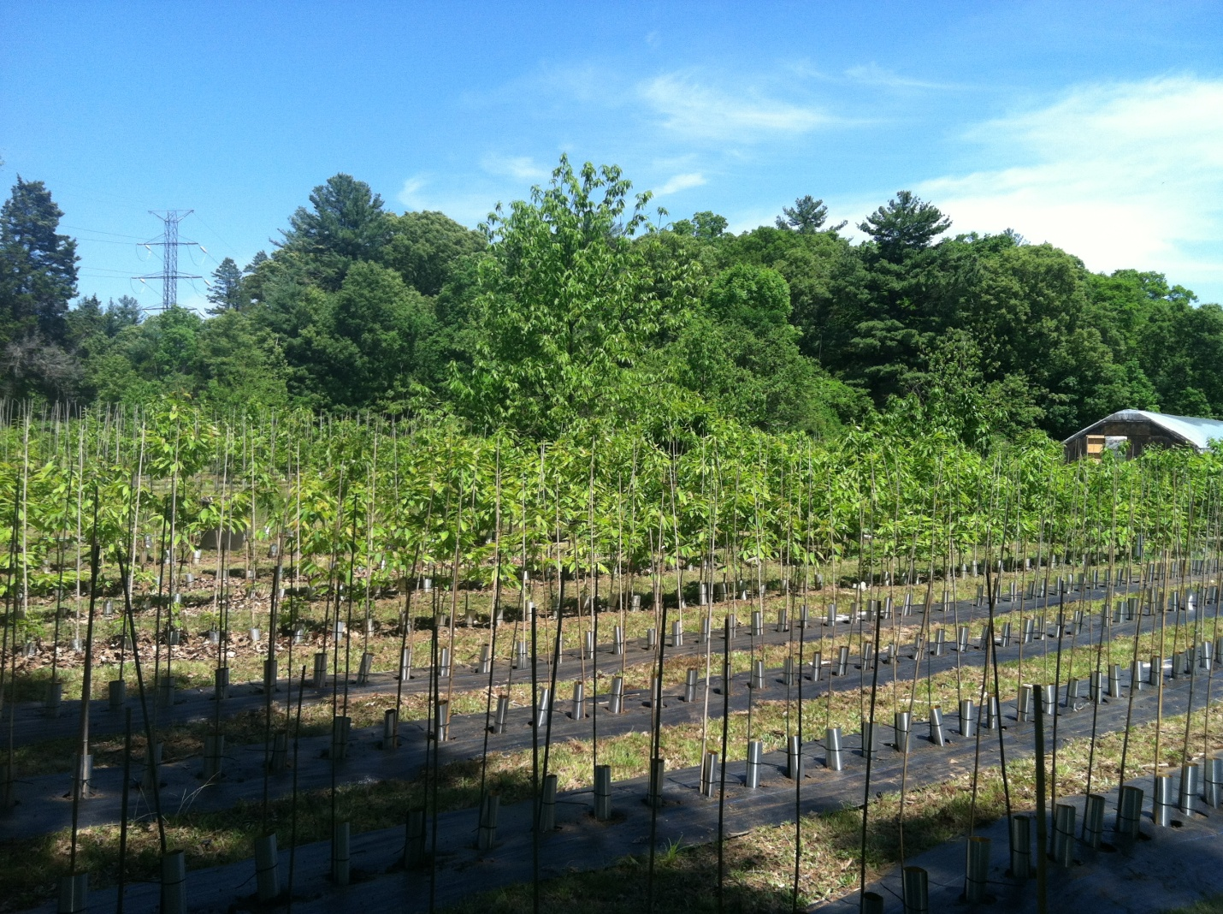
Weston MA

Slide 7
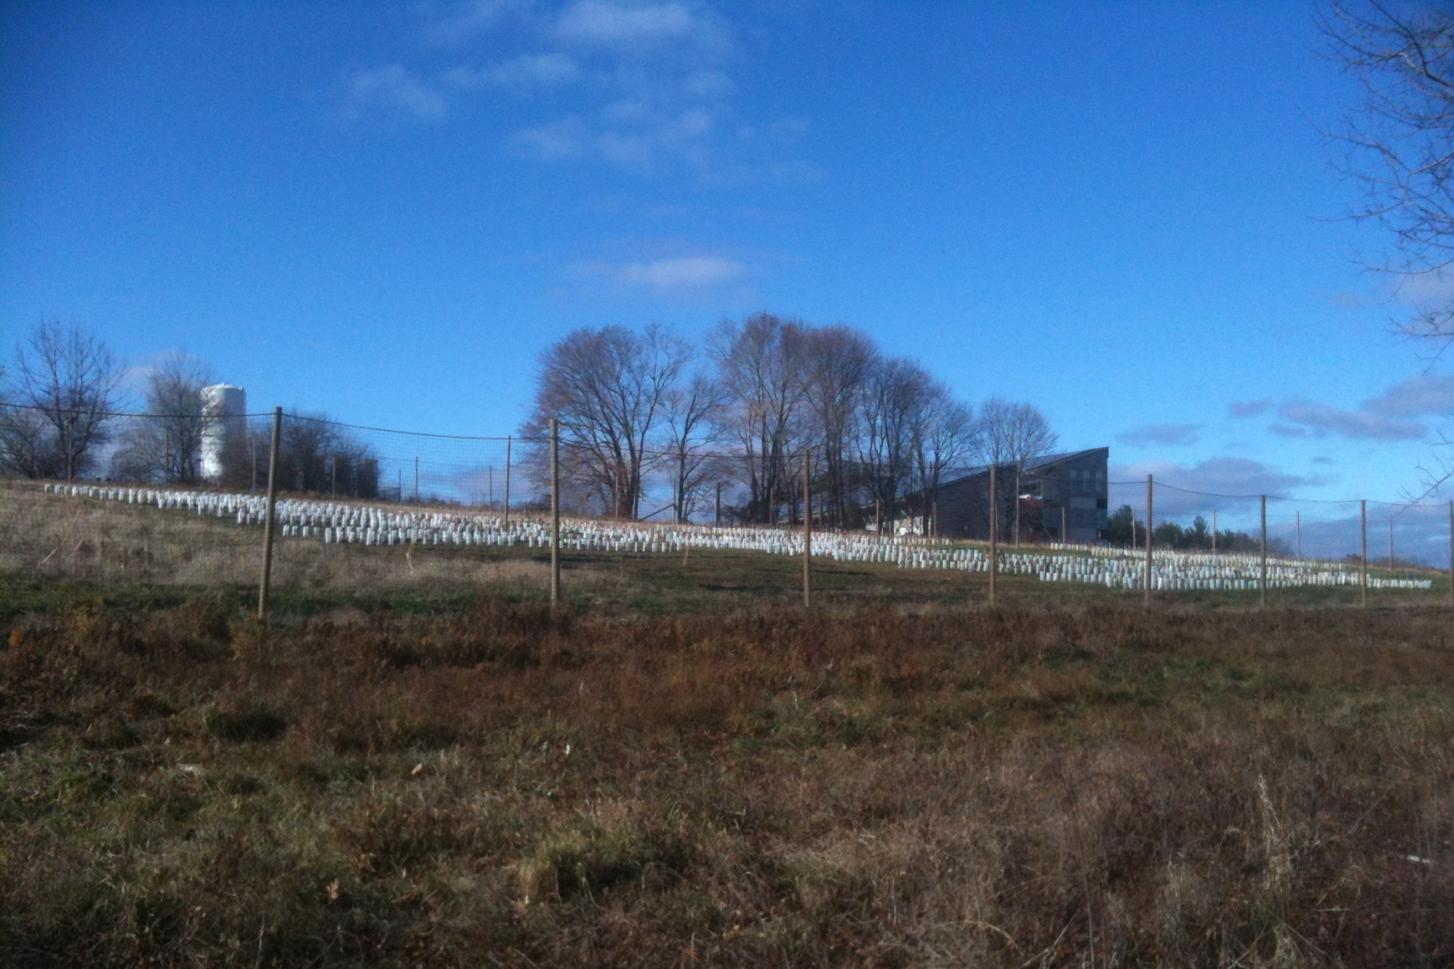
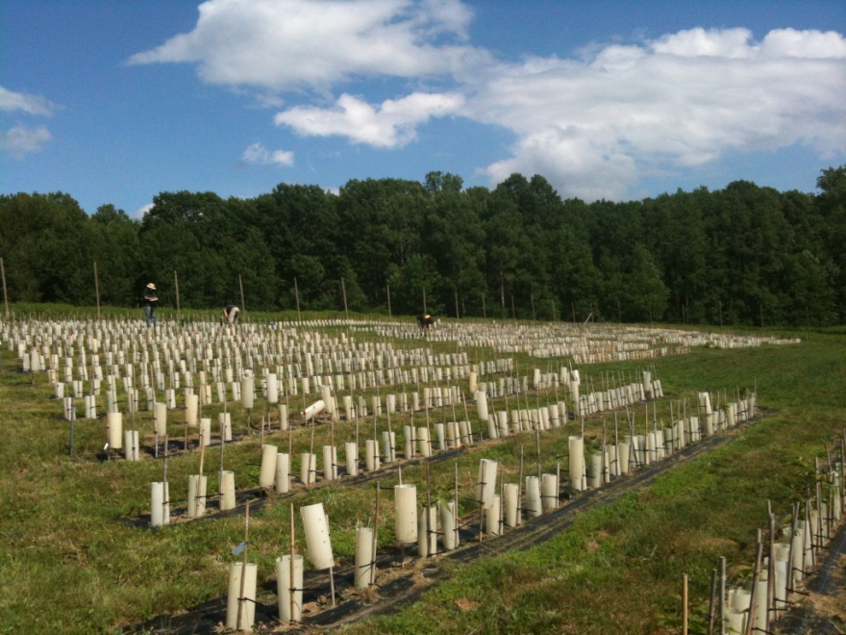
Mass Fisheries & Wildlife, Westborough MA
.

Slide 8
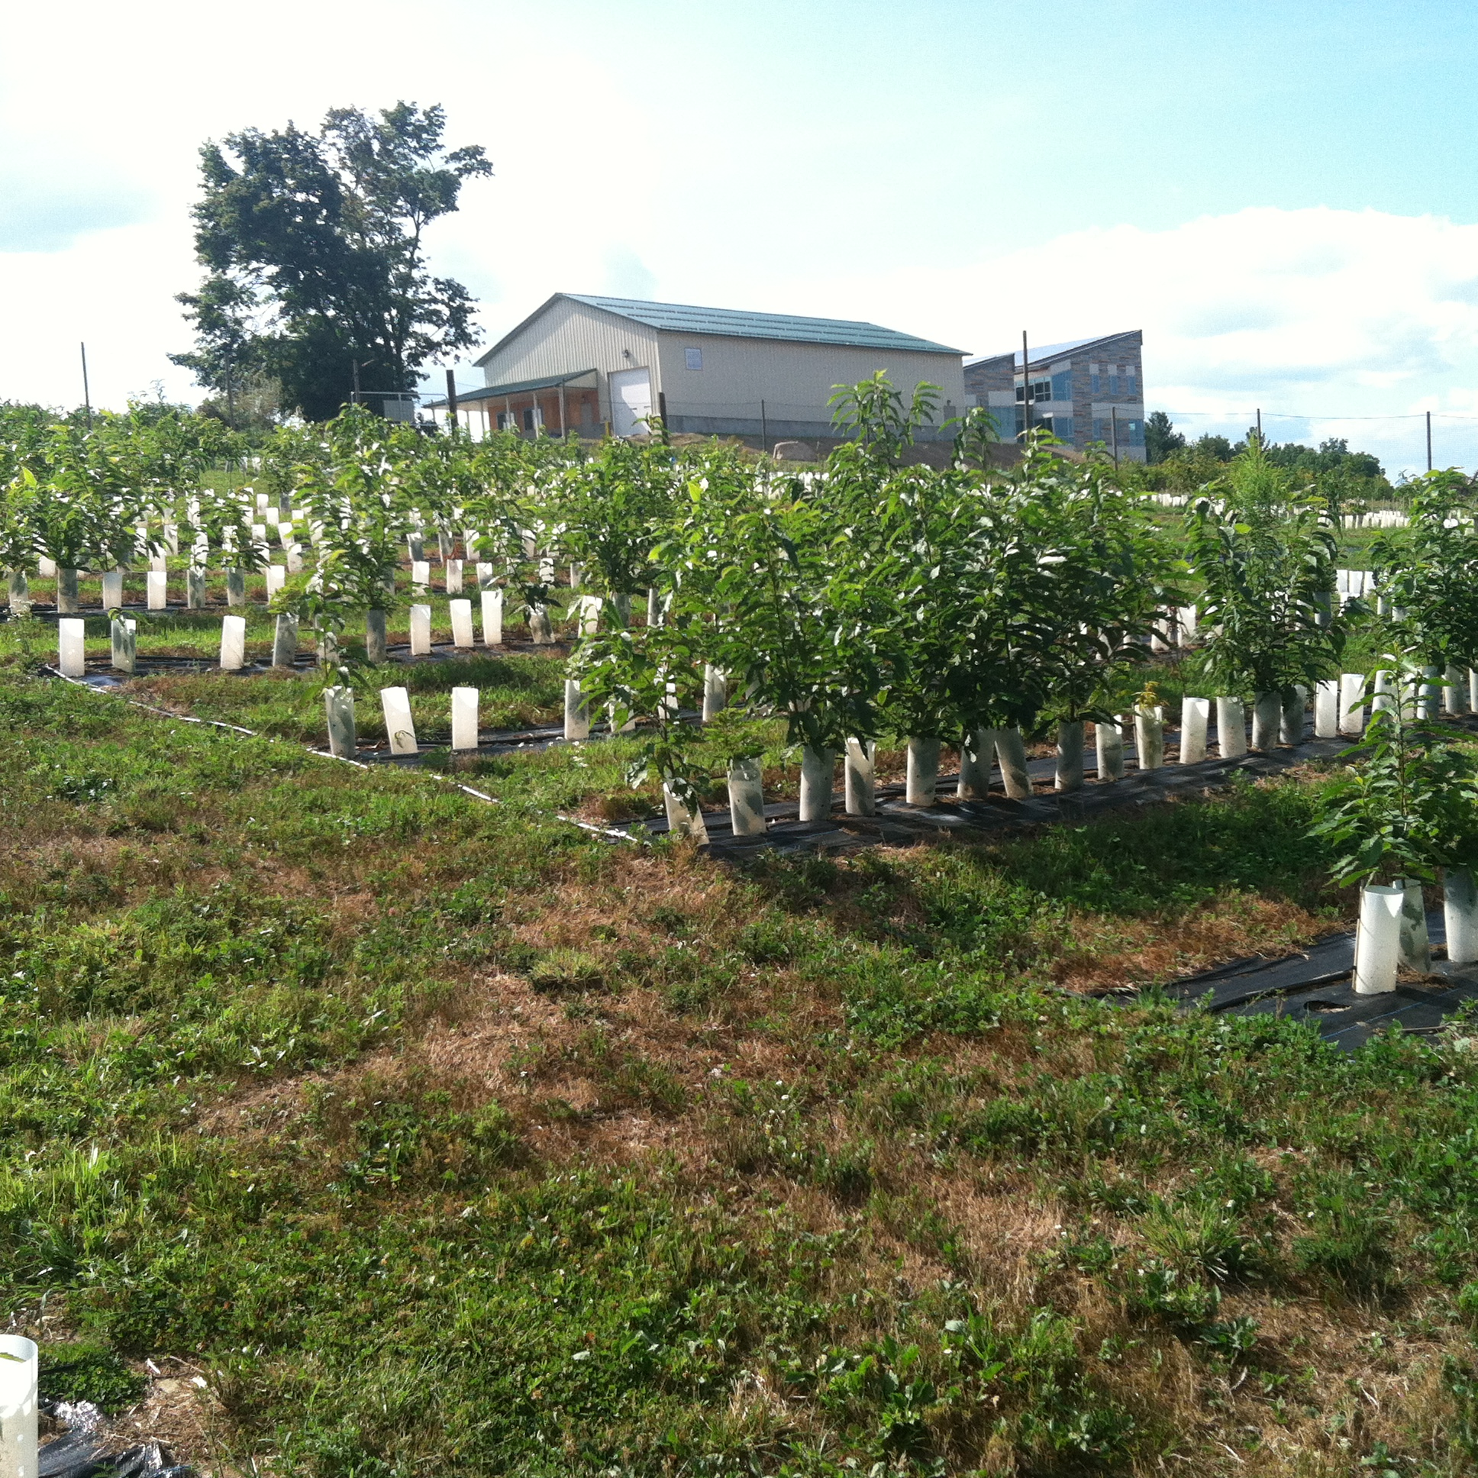

Slide 9
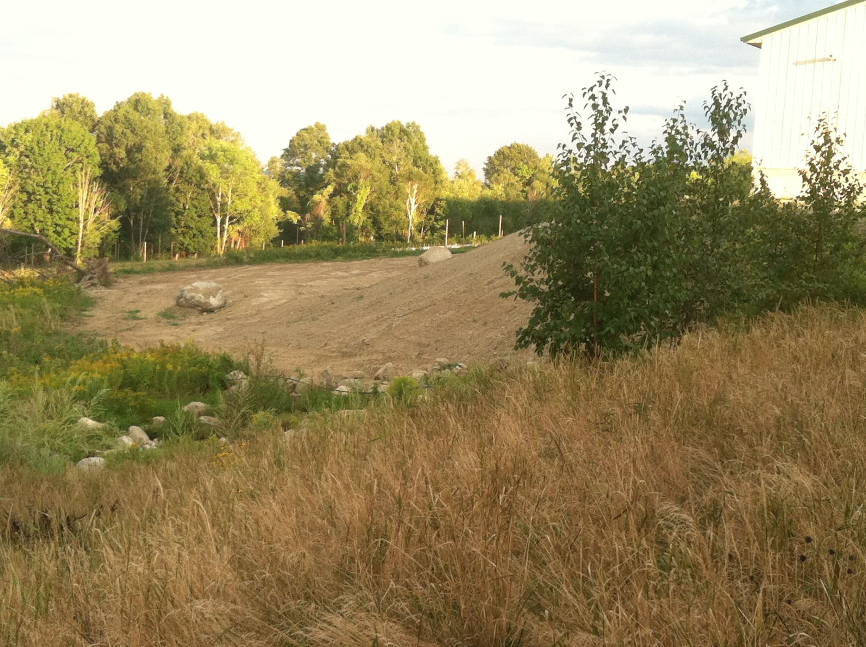

Slide 10
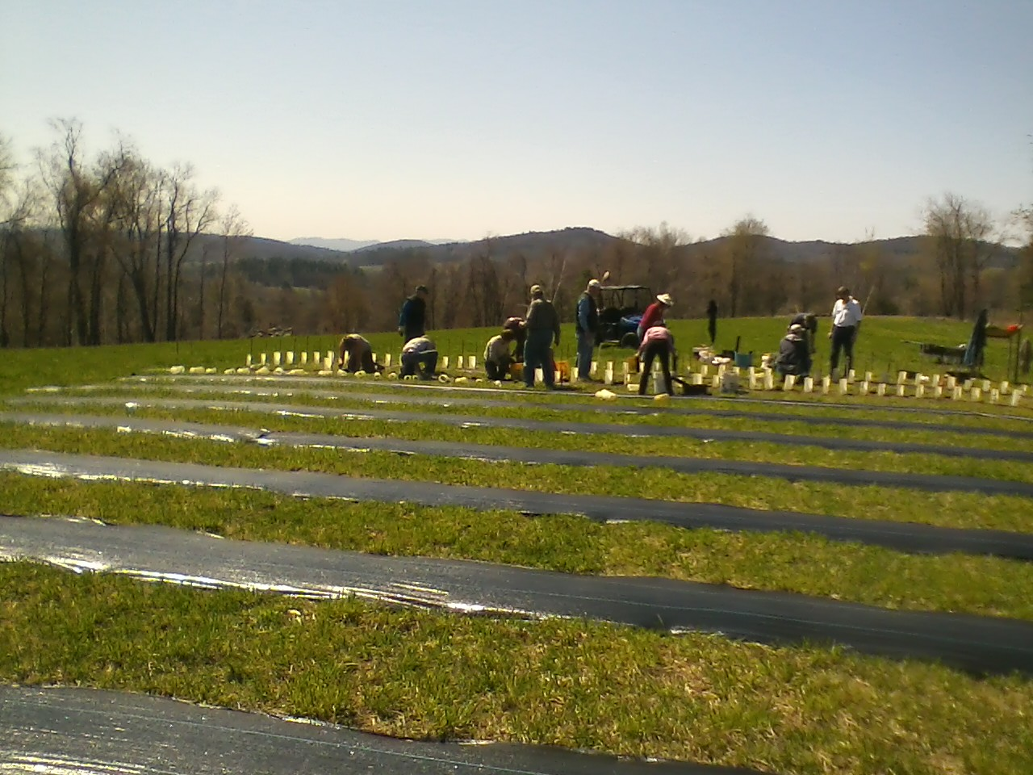
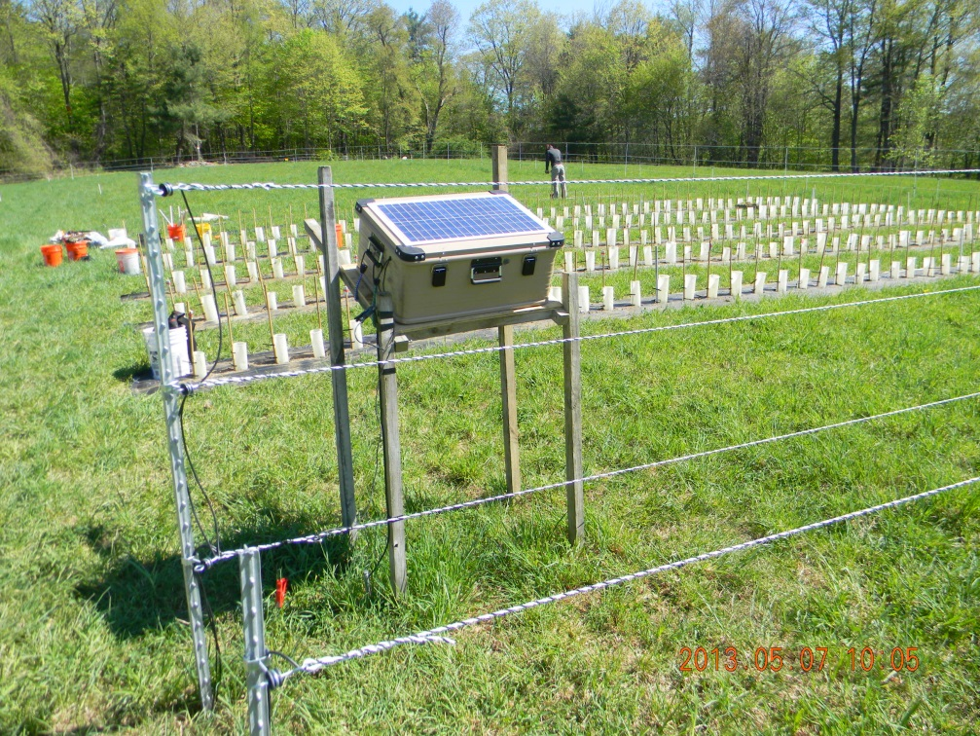
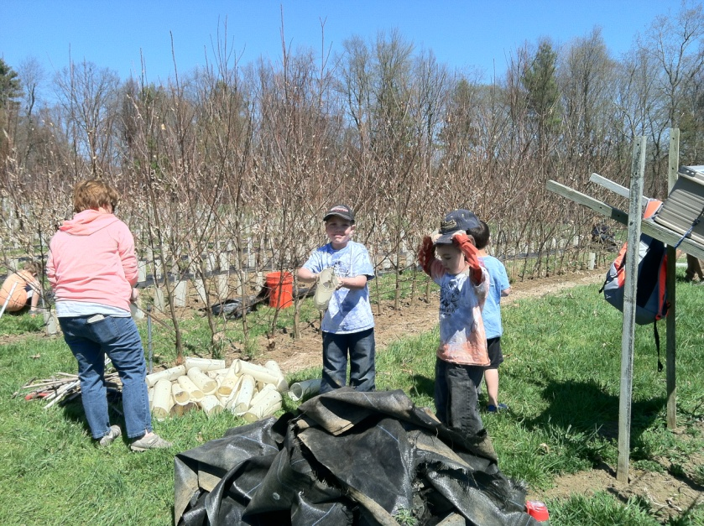
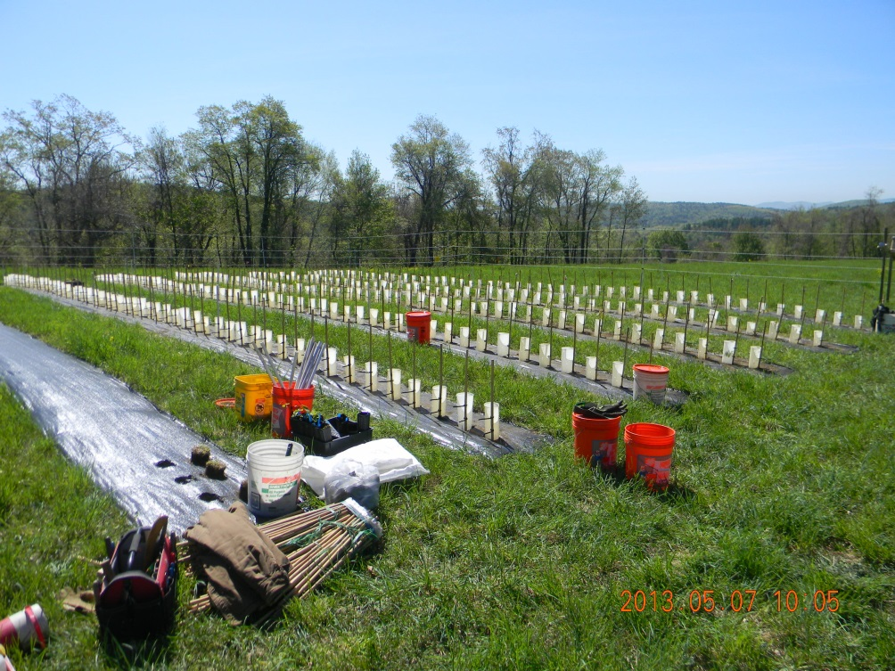
Notes:
Professor Paul Wetzel and his students are our have completely integrated the planting and ongoing care of a seed production orchard at Smith College’s Ada & Archibald MacLeish Field Station in Whately Massachusetts.

Slide 11
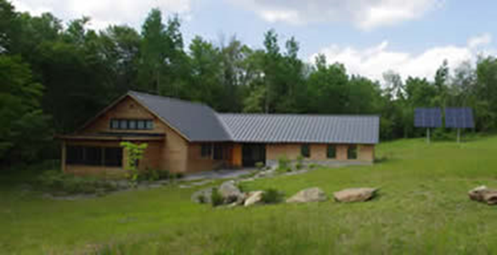
Ada & Archibald MacLeish Field Station
Whately, Massachusetts

Slide 12
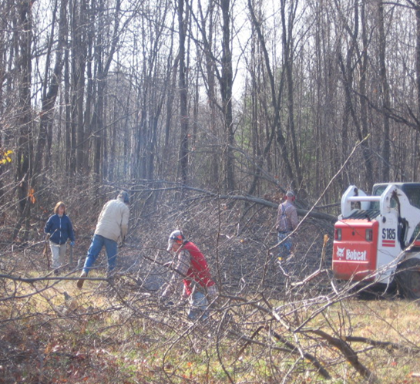
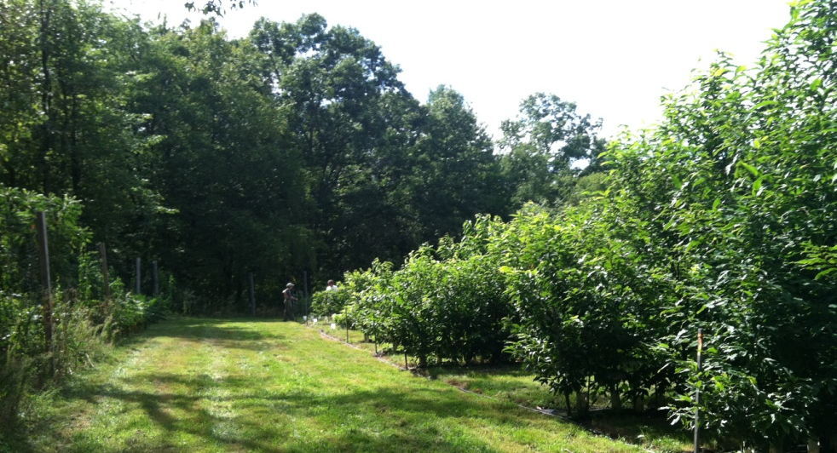
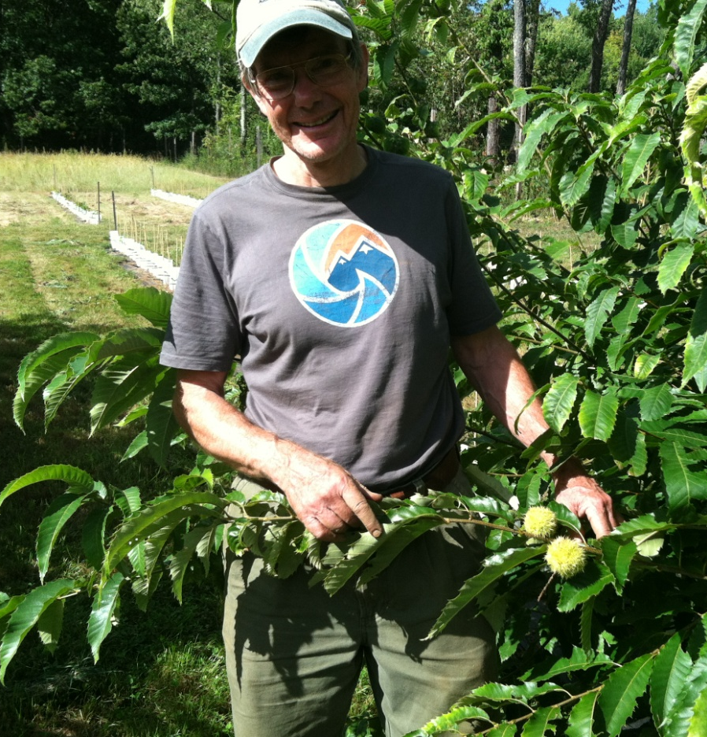
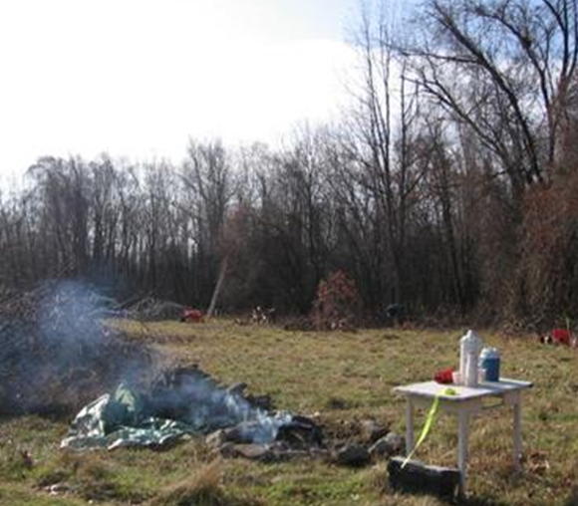
Granville MA
Notes:
Preparation for the seed production orchard in Granville MA began one whole year before planting.
The site is on private property, so a CR was required. It was part of a farm property, where the fields had begun to progress into forest. We took down trees, then later burned this material on site.
Next, the land was harrowed and planted with a crop of winter rye.

Slide 13
2016 breeding program update
Notes:
They need to feel that their contribution is important, needed and appreciates.
Give them recognition is some way, whether it be in writing with a certificate, newspaper story, letter to the editor, a plaque, etc.
Give them the opportunity to participate in decisions.

Slide 14
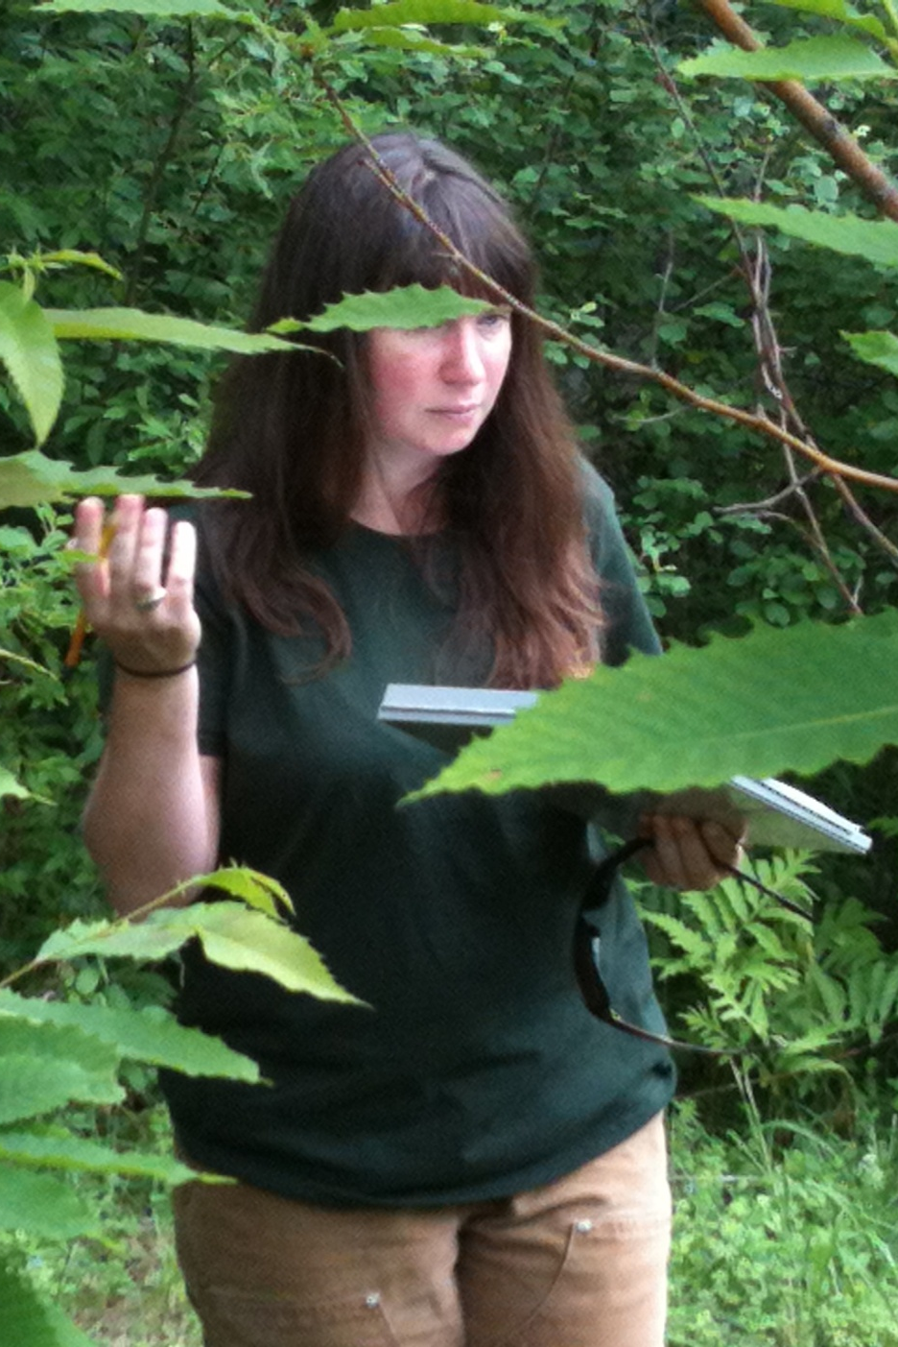
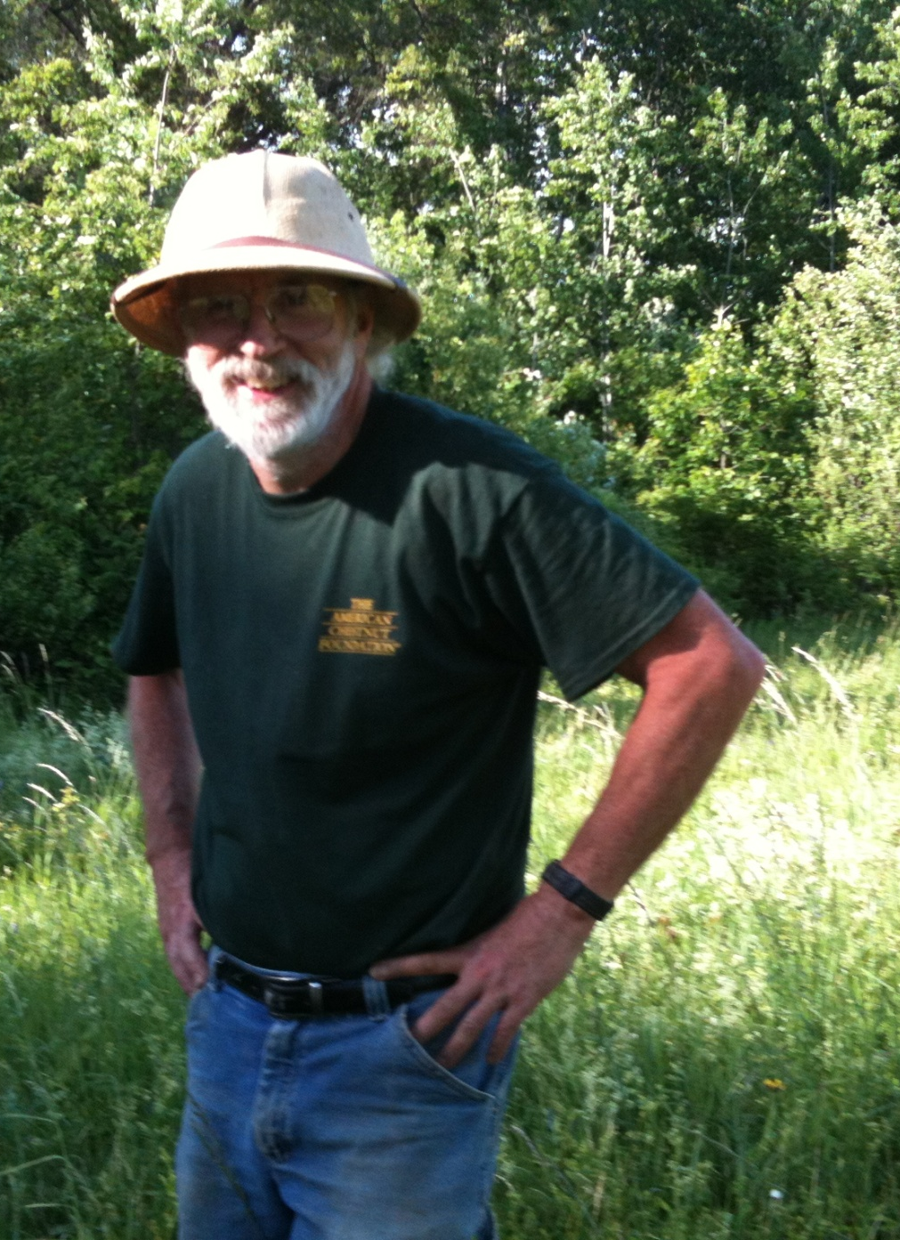
Notes:
A good manual will have somewhat of a “roadmap” for people, even if it’s just a 5 minute talk at the beginning of a volunteer experience.

Slide 15
breeding orchards
MA/RI ORCHARD SUMMARY
15 Clapper orchards with 32 lines
10 Graves orchards with 20 lines
5 Nanking orchards with 13 lines
Pollinations done this spring for 2 new lines
Notes:
Make sure to keep in mind the volunteers abilities. We always need to look at age, level of experience, generally look at a person’s capabilities before we assign tasks.

Slide 16
Ma/ri 2016 planting summary
Approx 10,600 nuts & seedlings planted this spring!
SEED ORCHARDS
5 Clapper orchards – 7 blocks
1 Graves orchards – 1 block
50+ plots this spring & replants making 119 plots planted to date.
BREEDING ORCHARDS
1 Nanking line this spring

Slide 17
Stacked resistance experiment
Using fully selected Clapper & Graves BC3F1 seed from 4
trees in 3 orchards we made 6 crosses this spring .
G1 x G2, G1 x C1, G1 x C2
C1 x G2, C2 x G2, C1 x C2
These will be grown in the same location (TBD) and comparison will be made to see if Clapper x Graves (and vice versa) has significantly different resistance.
We will expand this to include Nanking in the future.

Slide 18
Demo plantings, partnerships, festivals & fairs

Slide 20
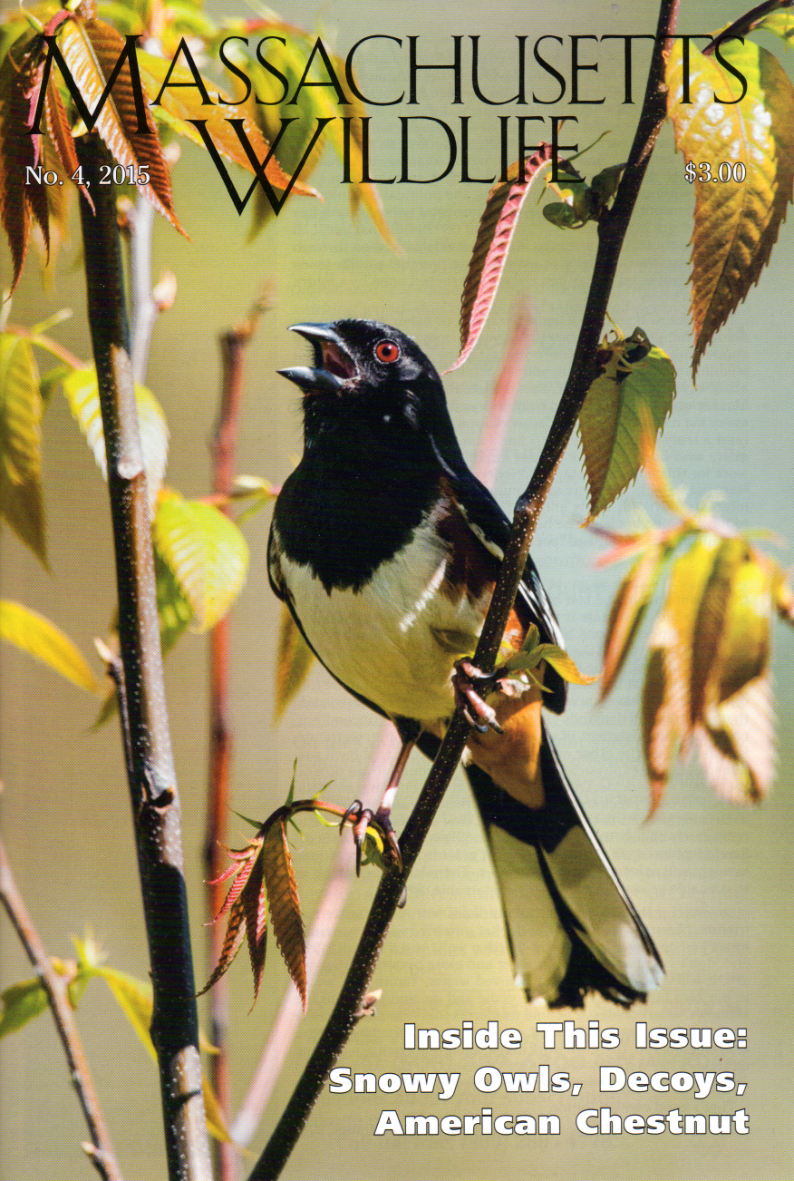
Massachusetts Division of fisheries and Wildlife
Notes:
Follow through on Maslow’s Hierarchy of Needs.
Partnerships need to be documented and feel part of the “team.”

Slide 21
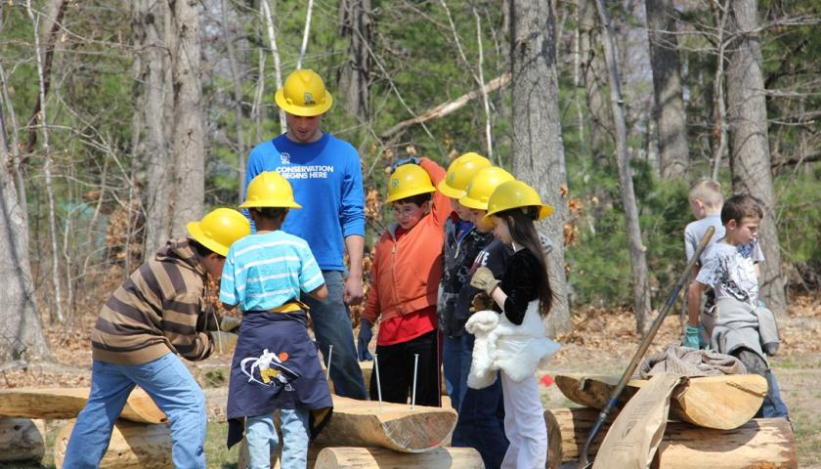
SCA Americorps

Slide 22
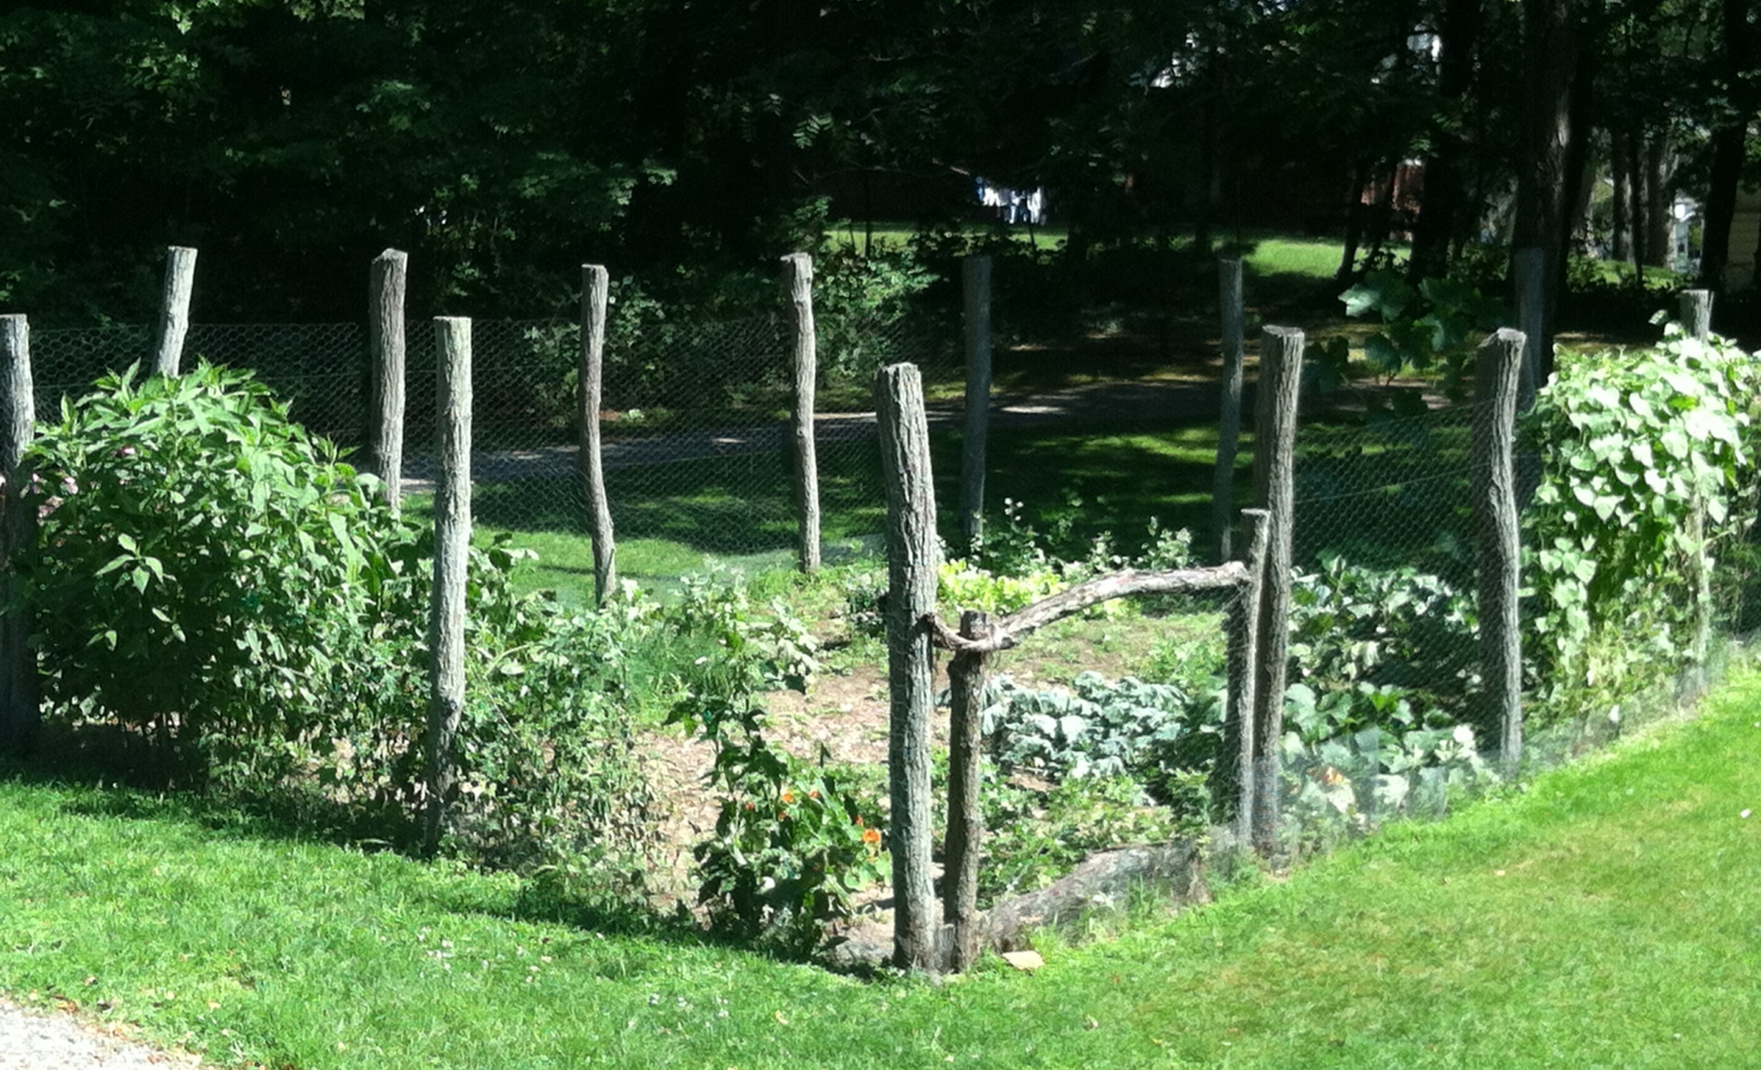
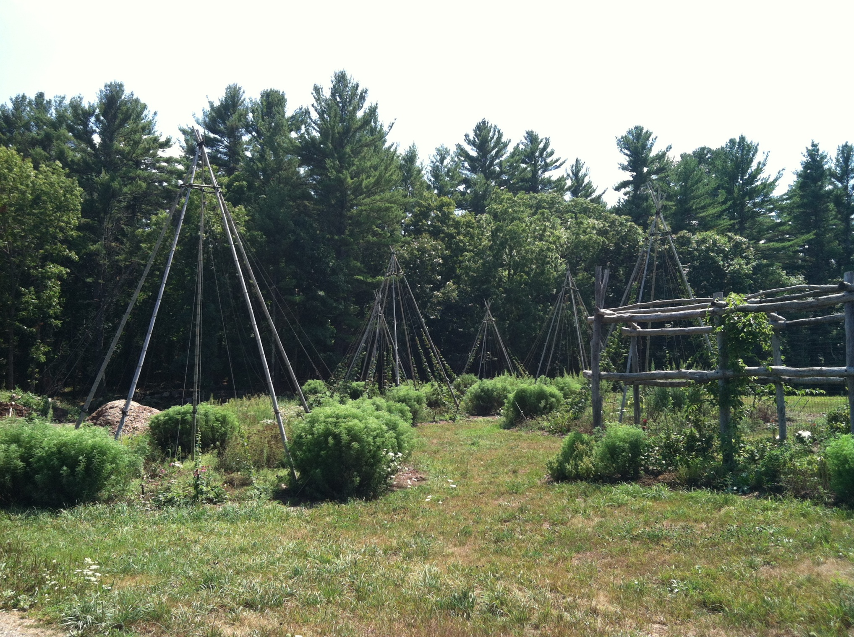
ifarm, Boxford MA

Slide 24
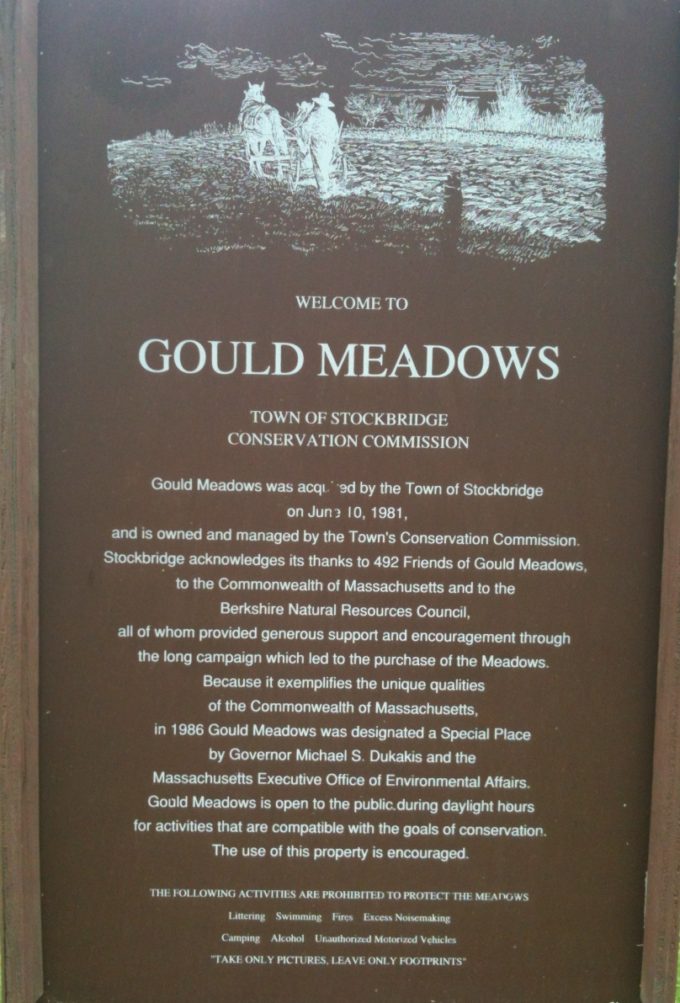
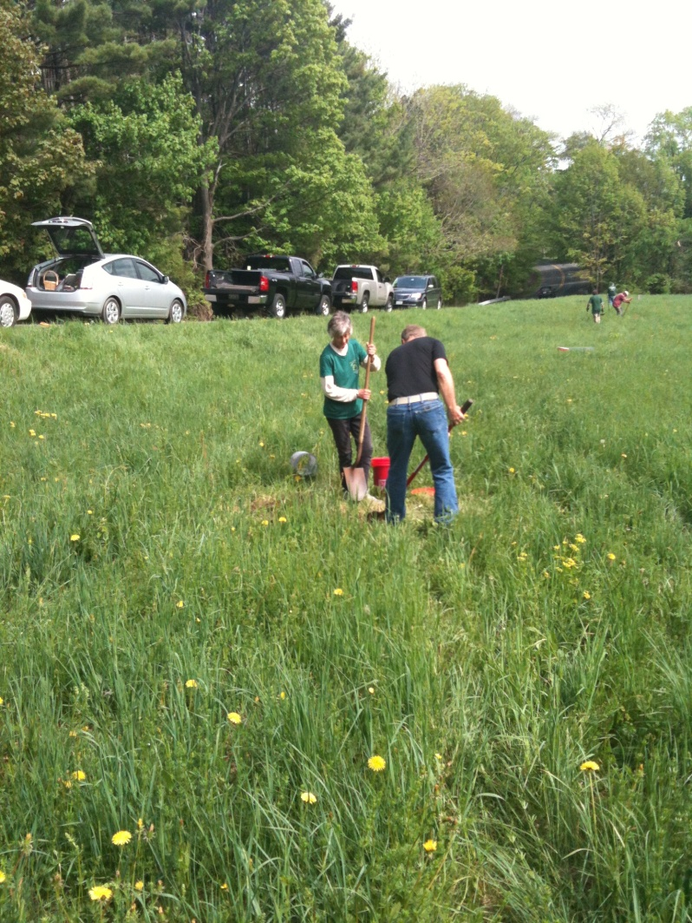
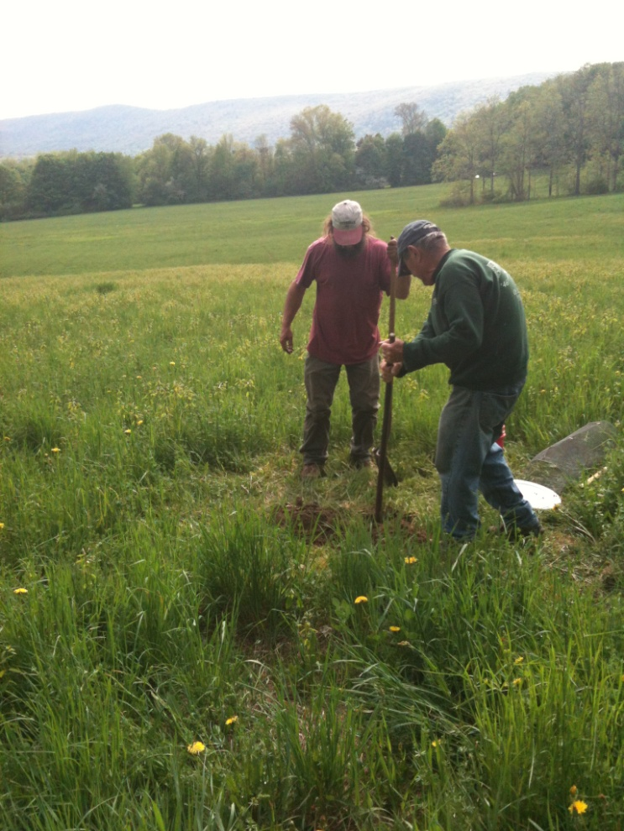
Notes:
Another - may look someone basic, but often times we really don’t always think about how we “present” to these people.
Think about working out in the sun, having enough water, taking regular breaks, etc.

Slide 25
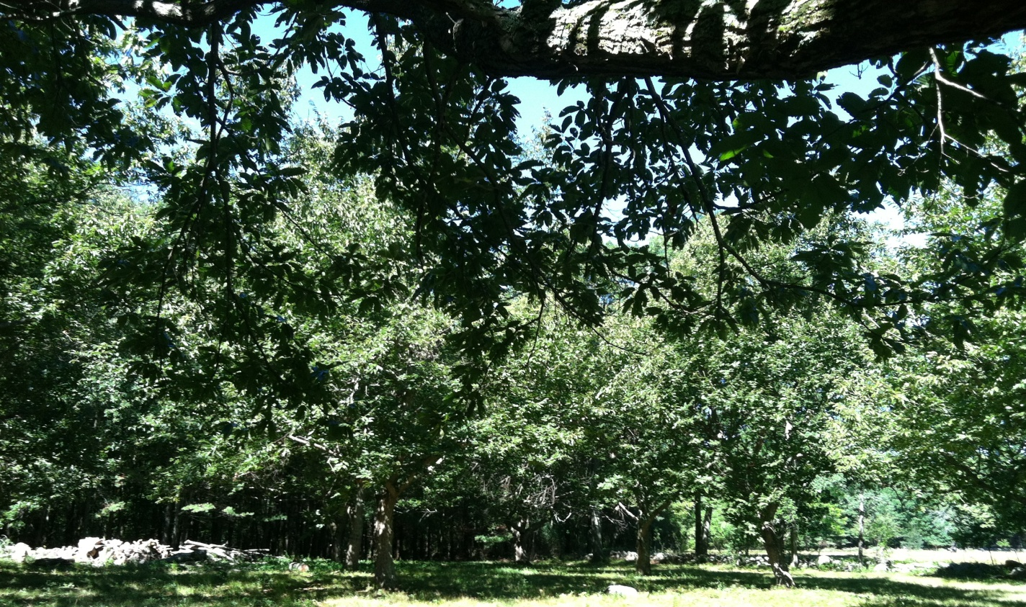
Bullard memorial farm holliston Ma
p

Slide 26
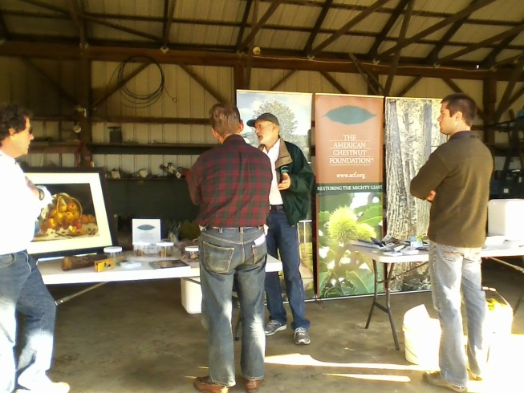
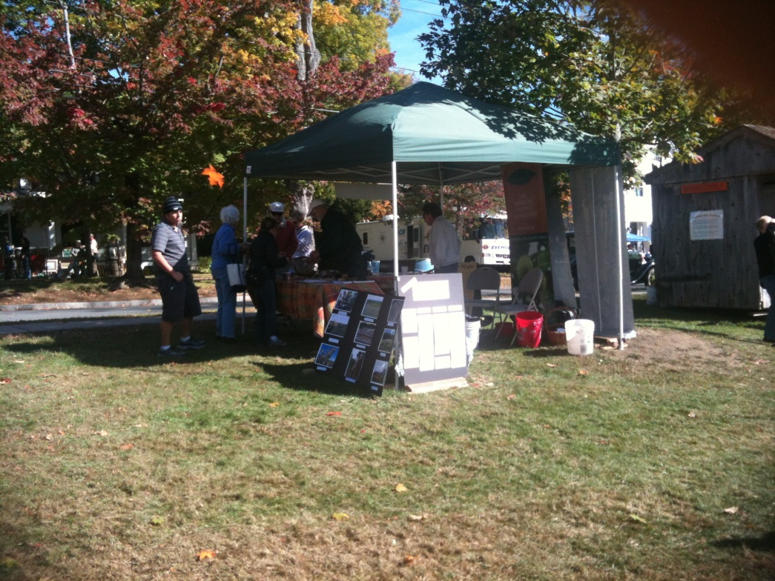
fairs
Notes:
Volunteers can help with many jobs, we just need to make sure that we designate tasks and each person knows what they are responsible for.

Slide 27
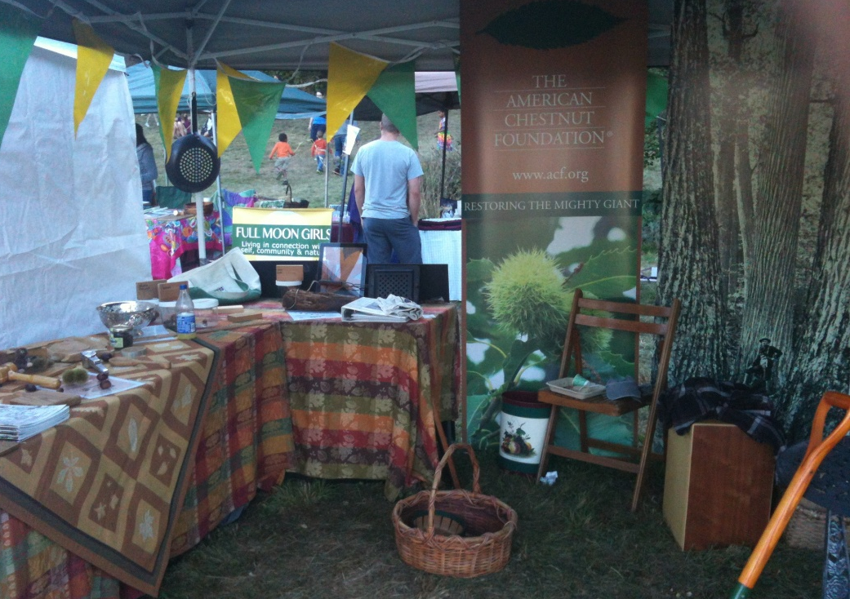
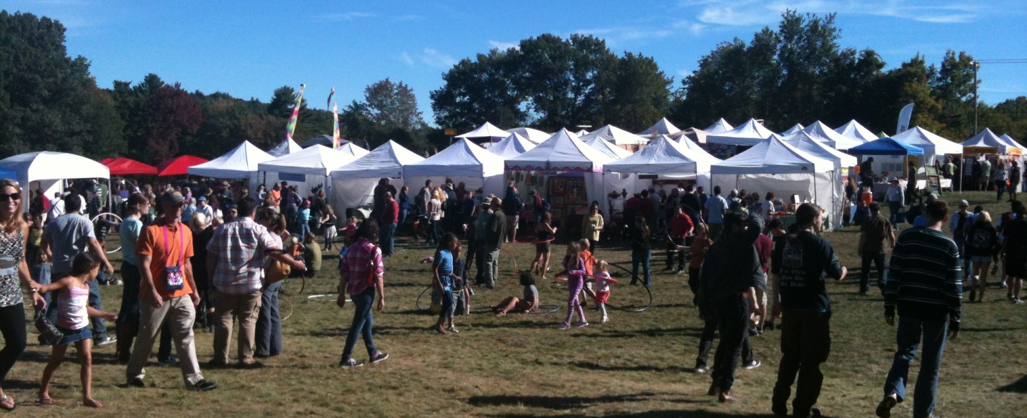
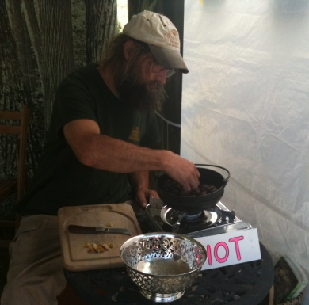
Notes:
Information sharing is one of the most important parts of partnerships and volunteer programs. People need to feel a part of the organization
Who will do what?
How will we communicate?
With whom?

Slide 28
Educational collaboratives
Tantasqua Regional Junior High School

Slide 29
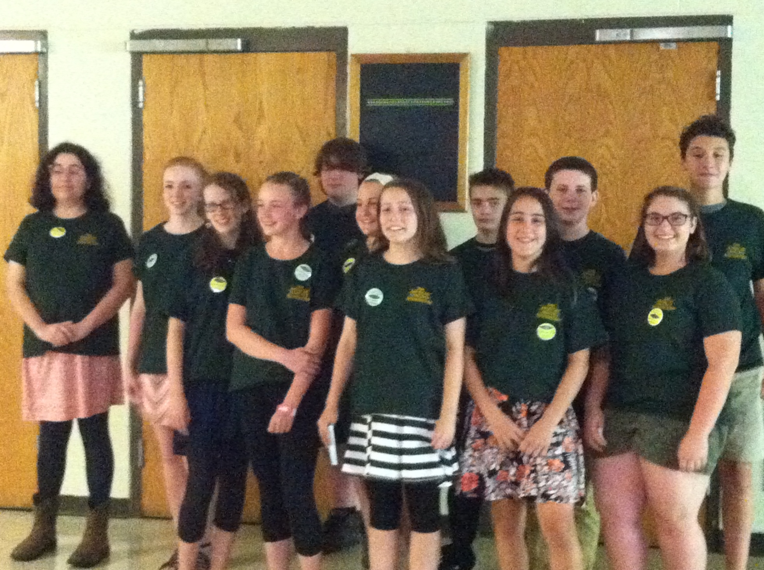

Slide 30
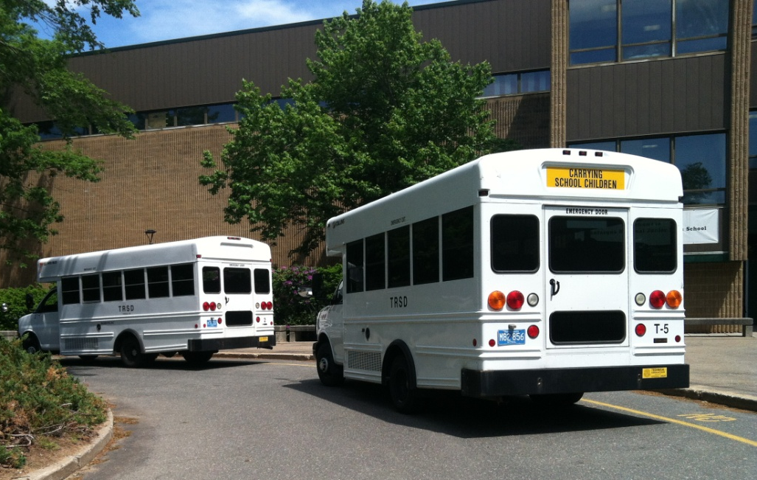
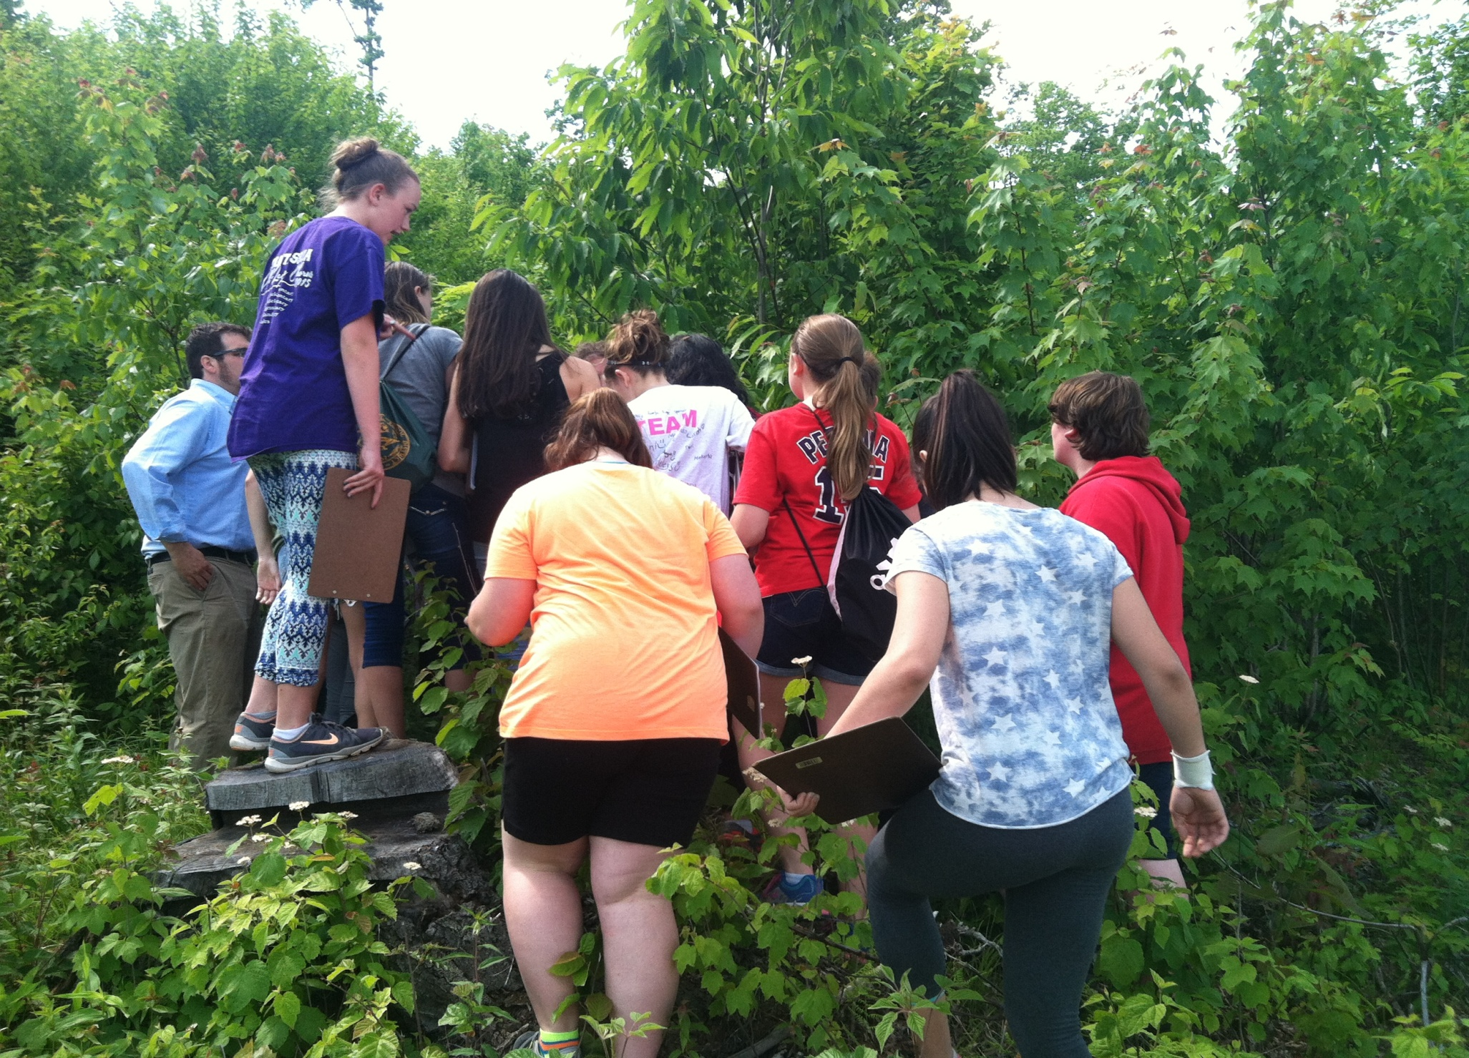
Travel to Mt ela, monson ma
Notes:
The more if Maslow’s Hierarchy that you can incorporate into both your programs and your volunteer program the more success you will have.

Slide 31
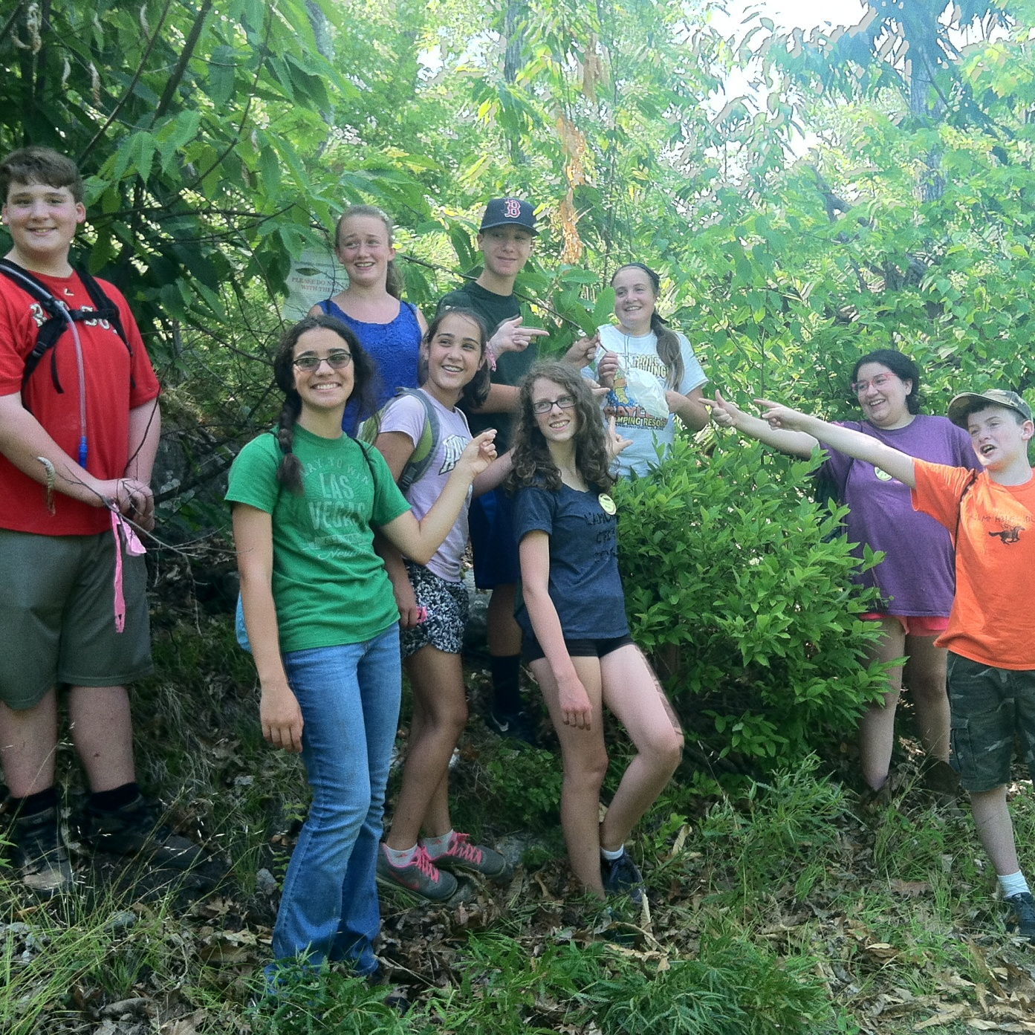
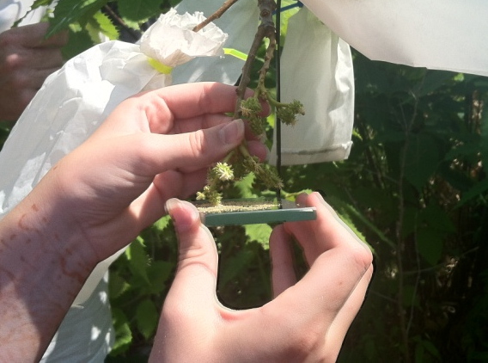

Slide 32
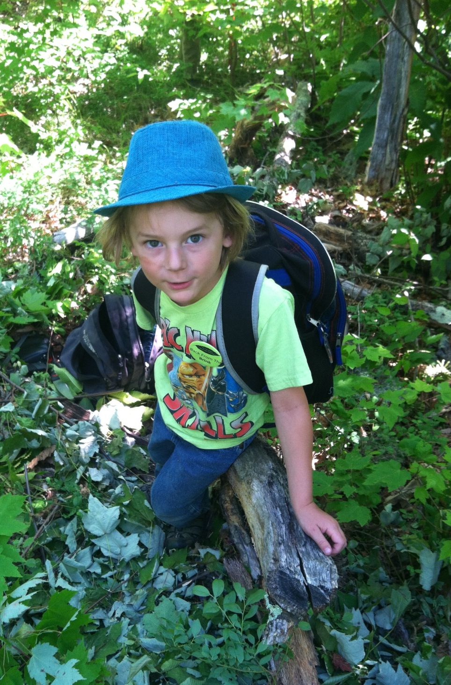
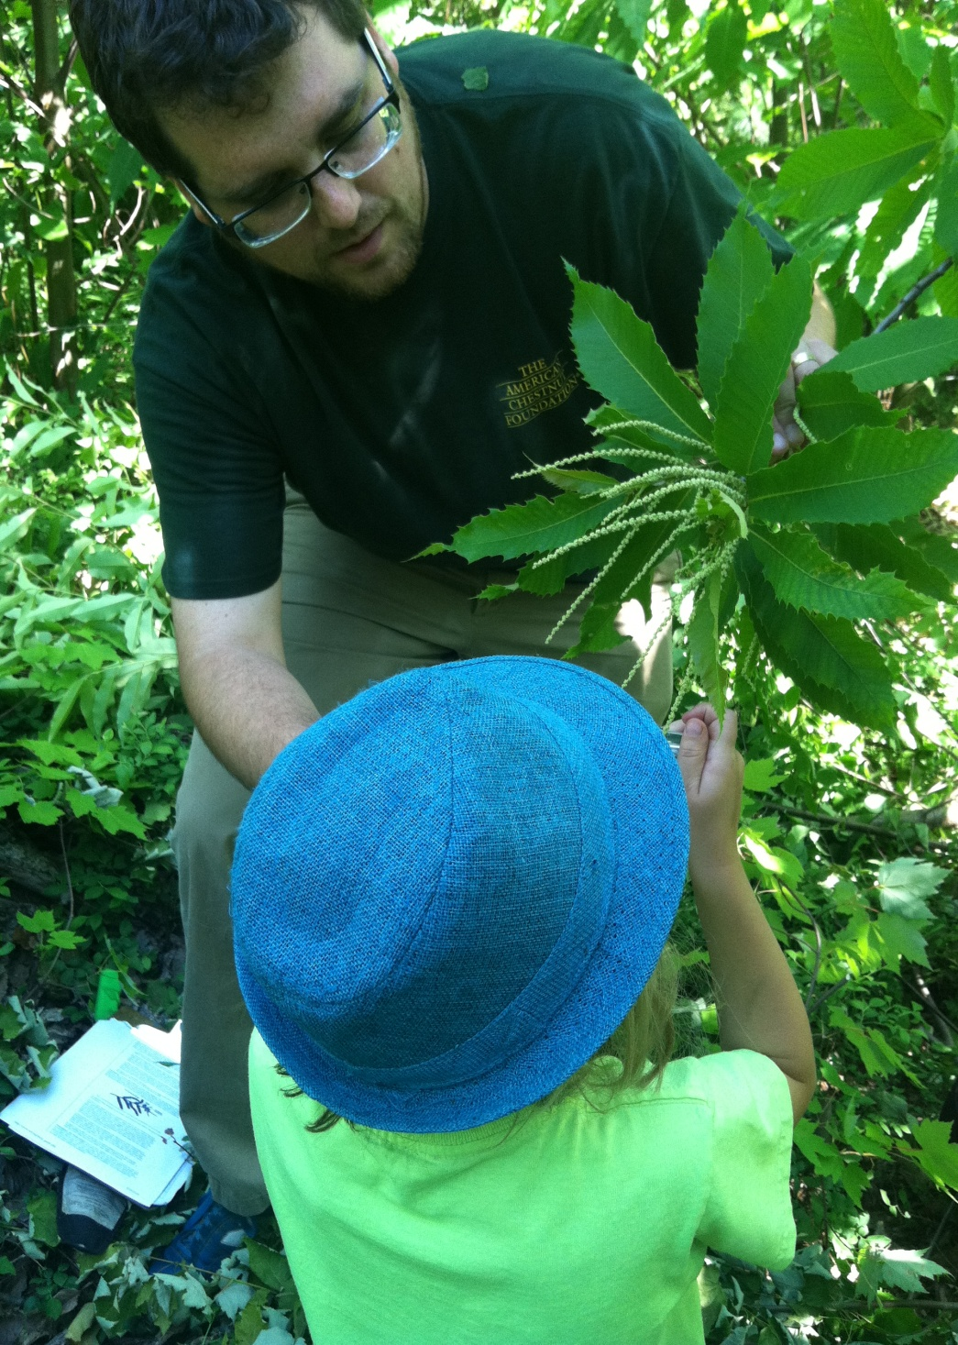

Slide 33
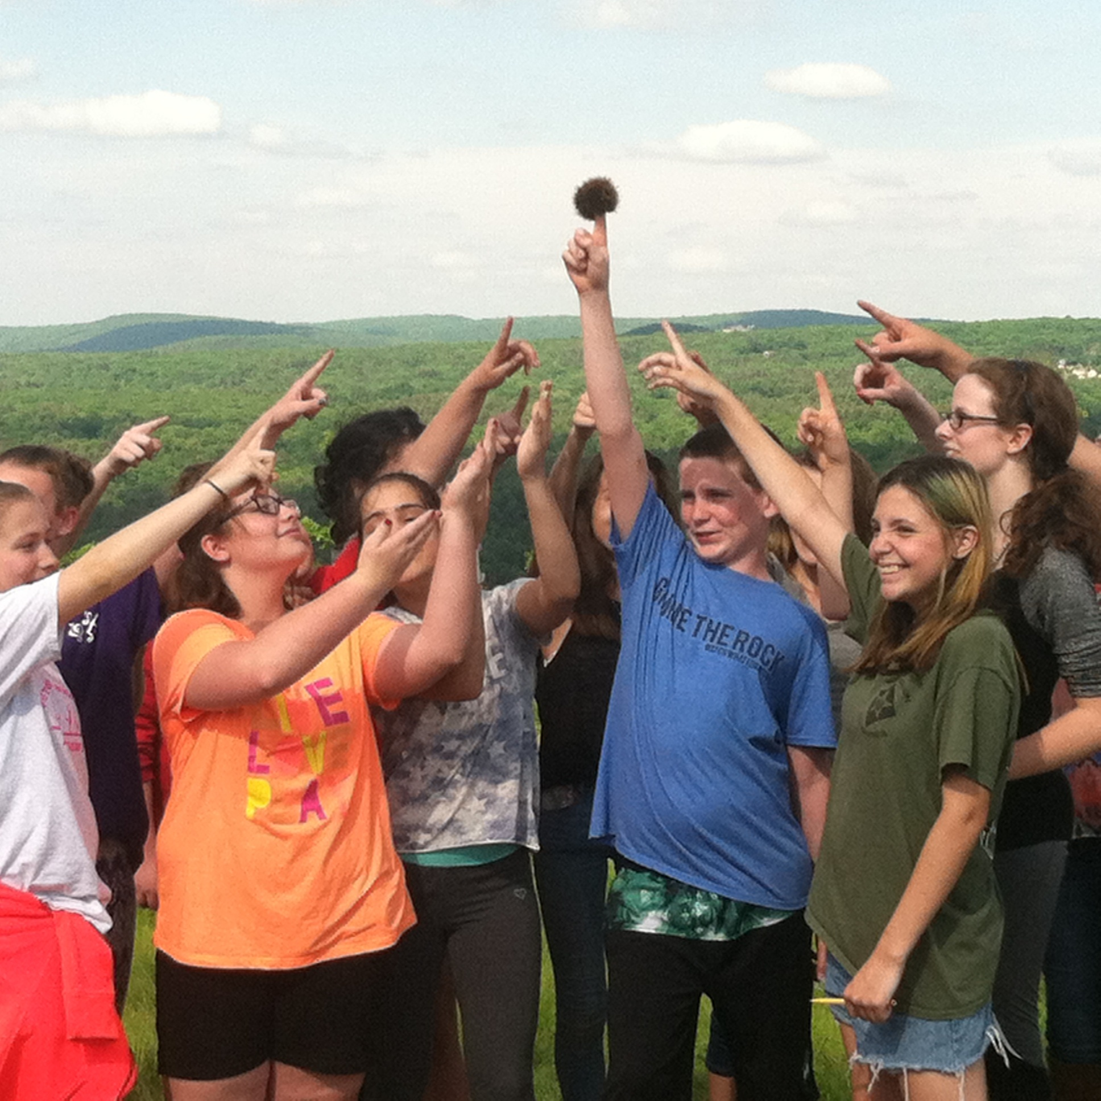

Slide 34
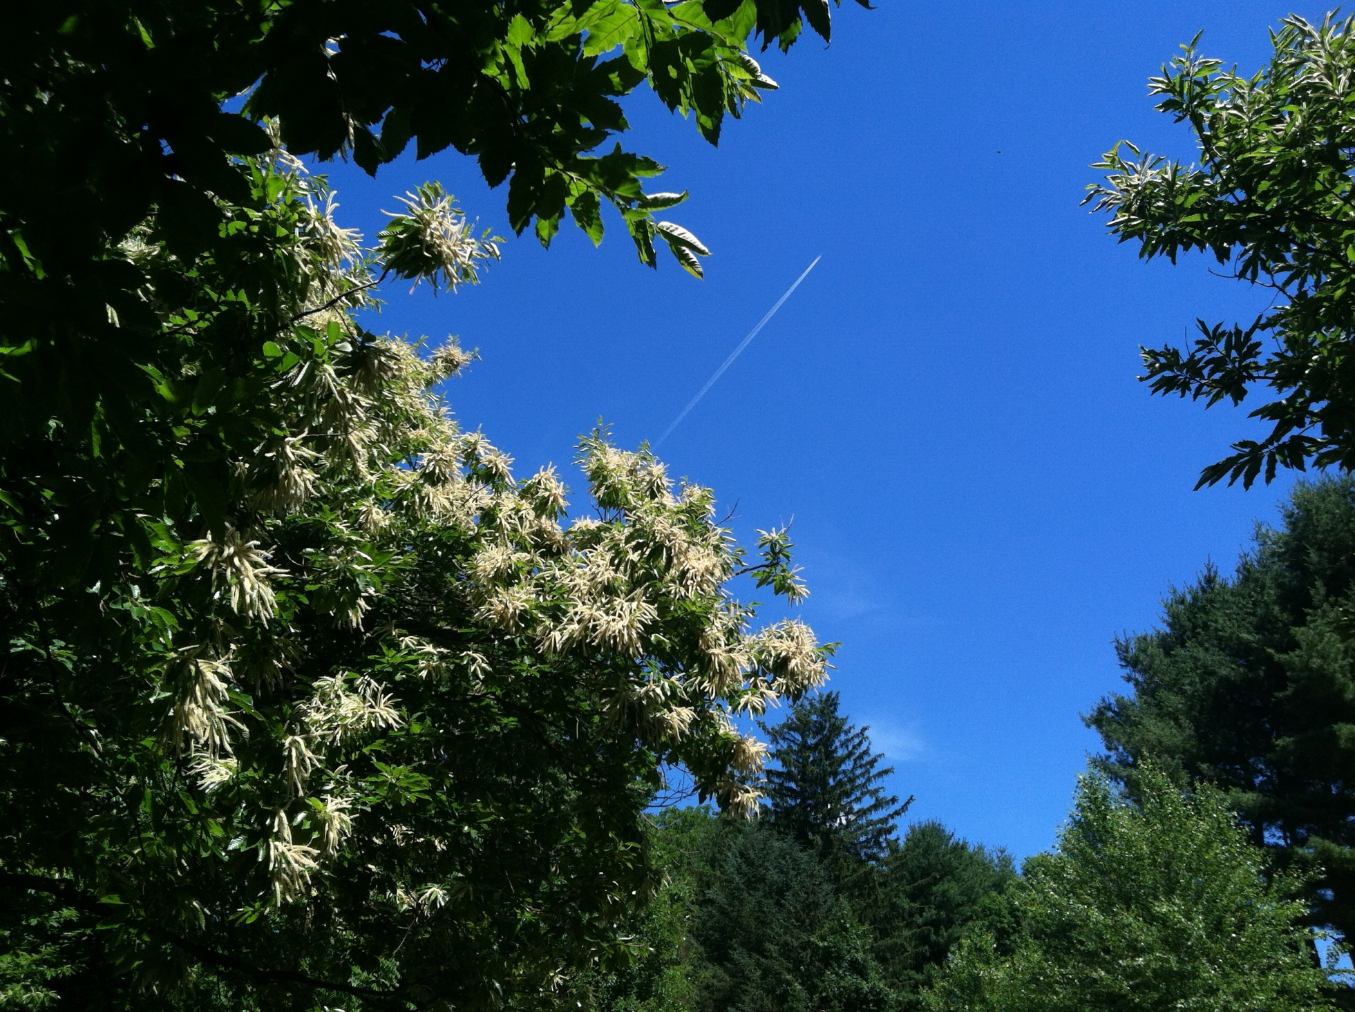
Research Opportunity for Science Class
Soars
Notes:
“South Pacific” great show, everyone was dressed in their usual “tux” outfits, including a sailor cap!

