Slide 1
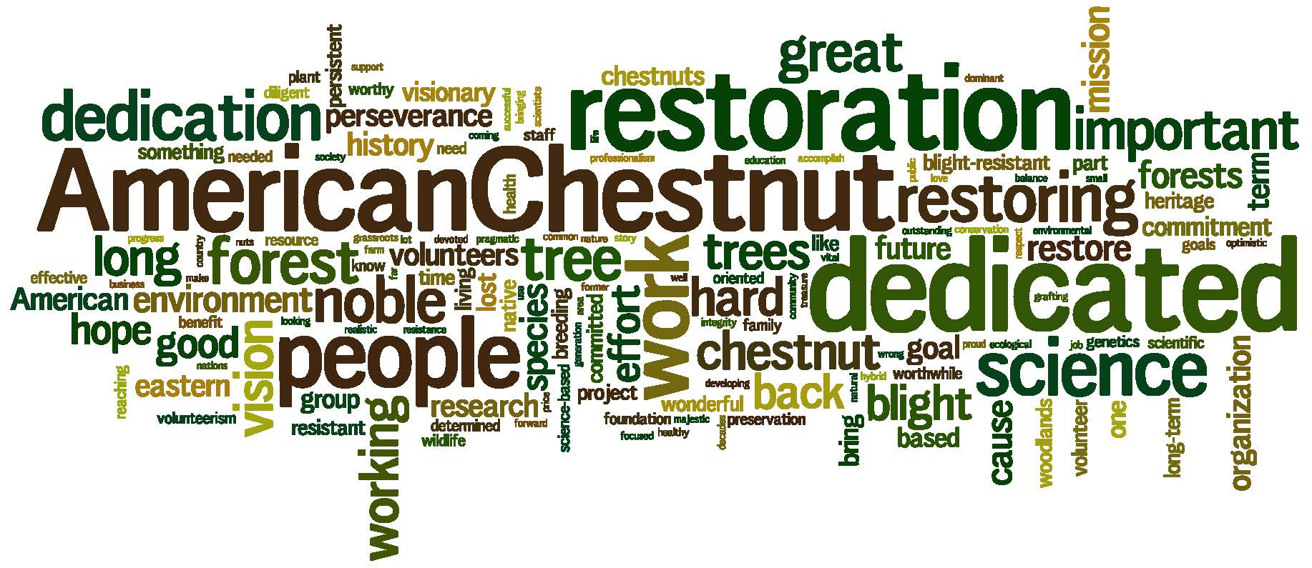
Notes:
Thank you for inviting us today.
We enjoy giving chestnut presentations around the state, but when we went online to look at your website for the first time, we were actually cheering inside our house!
What we’re going to tell you today is the story of the tragic loss of one of America’s most beloved trees within the space of just 2 generations. It’s also the story of hope, as everyone who cares about conservation can play an important role in its return.
Never before have we had a chance to be part of the de-extinction of a species. We do believe that the return of a healthy, blight resistant chestnut tree through back crossing is one of the most interesting scientific projects of our time, and one that depends largely on citizen science.

Slide 2
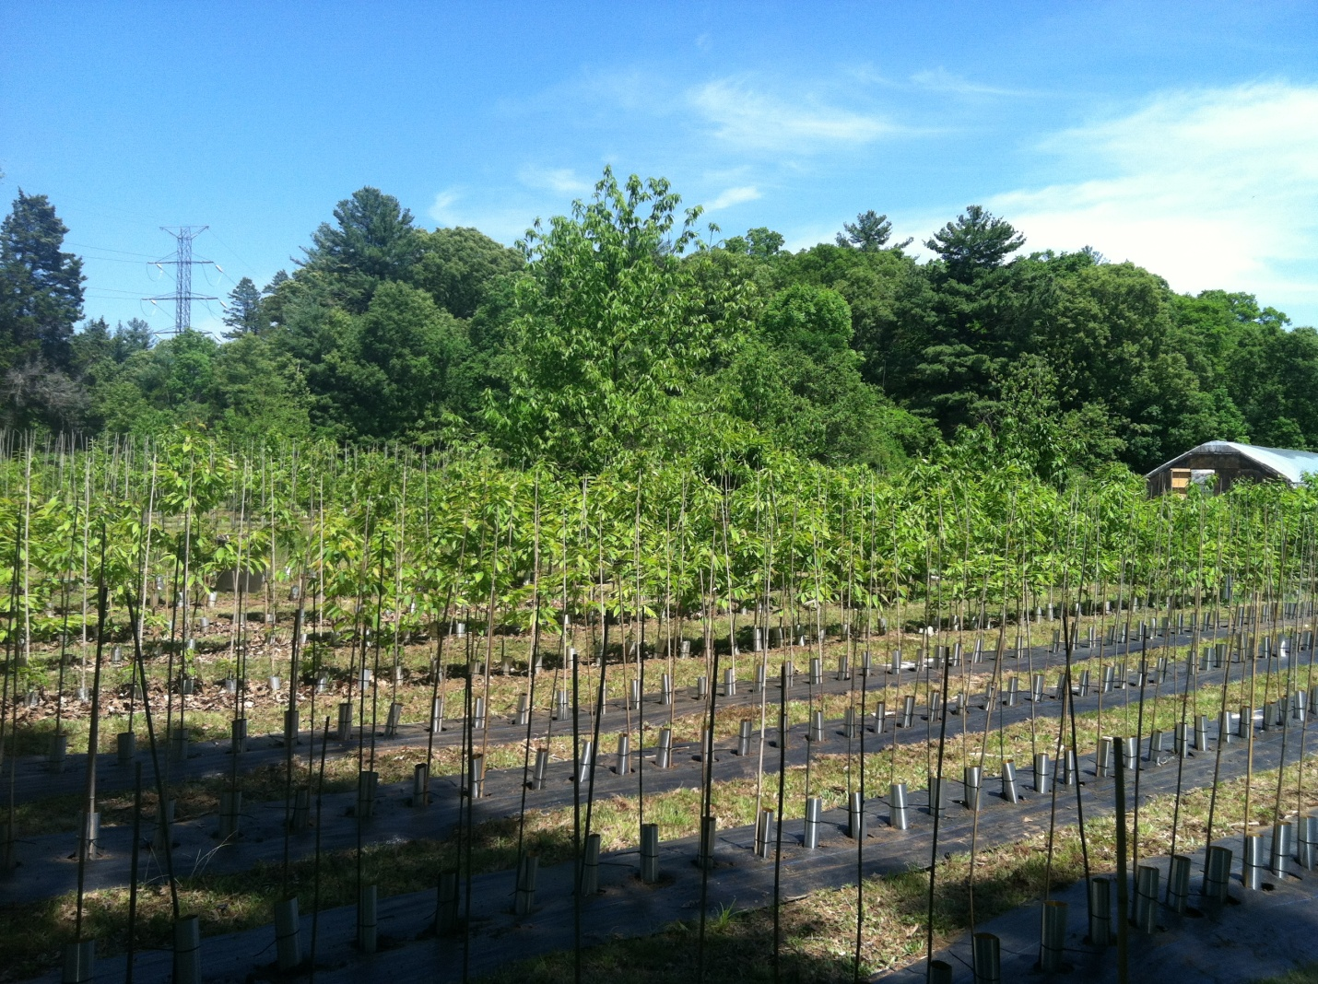
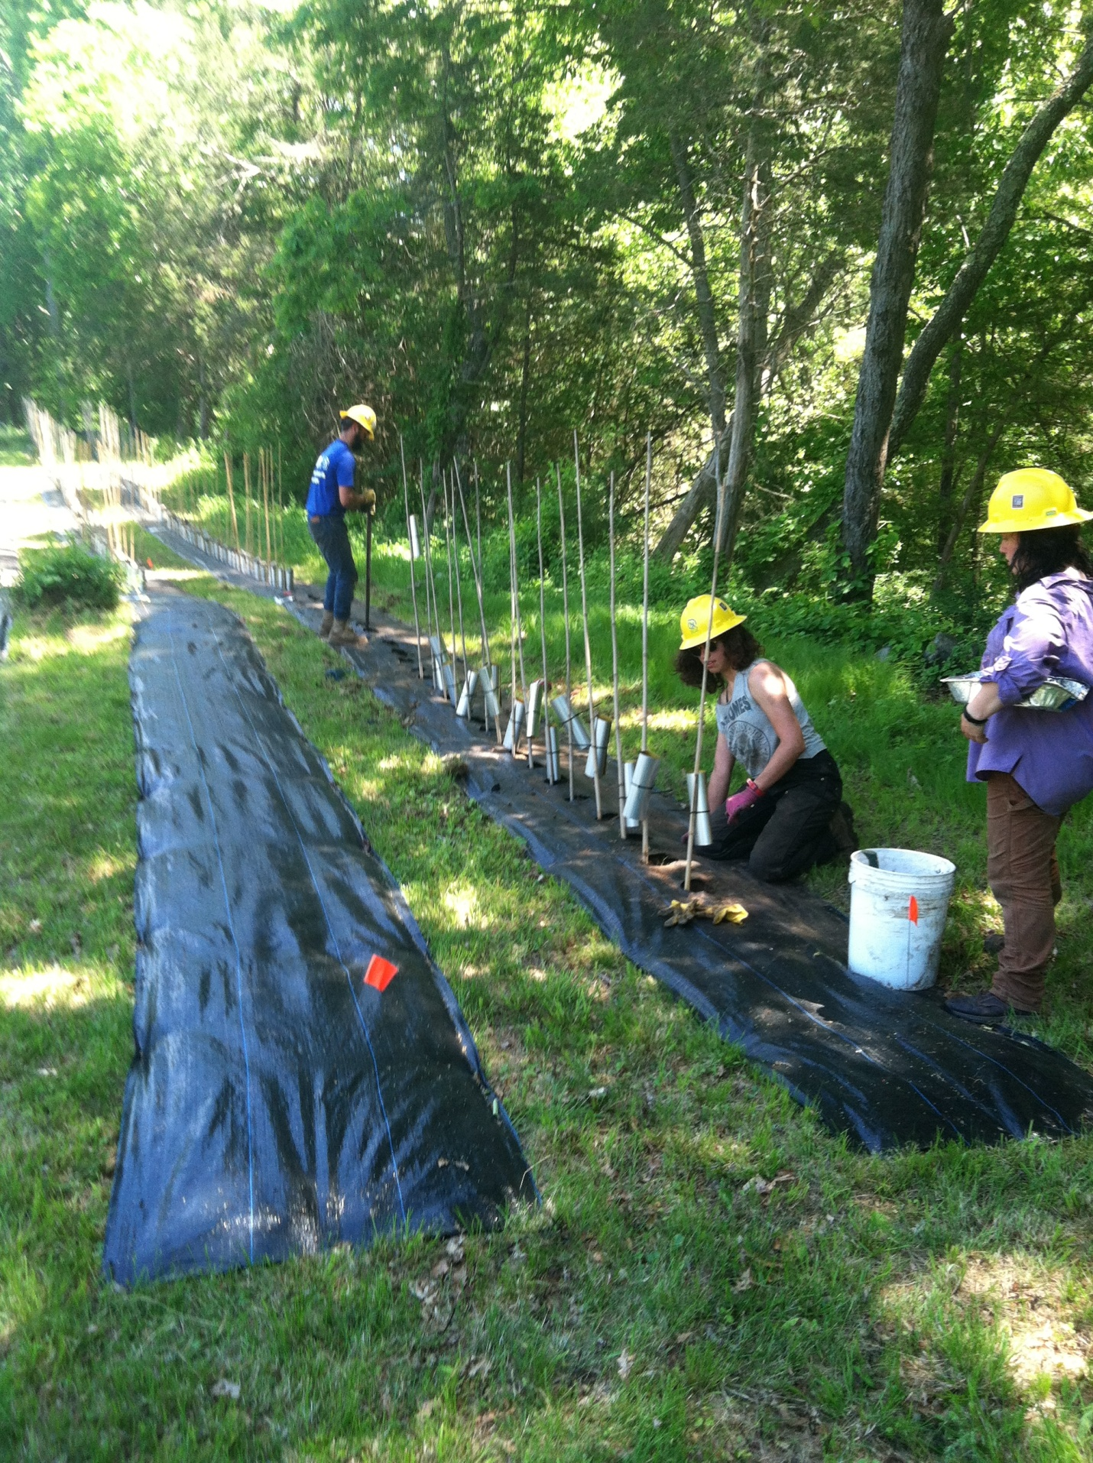

Slide 3
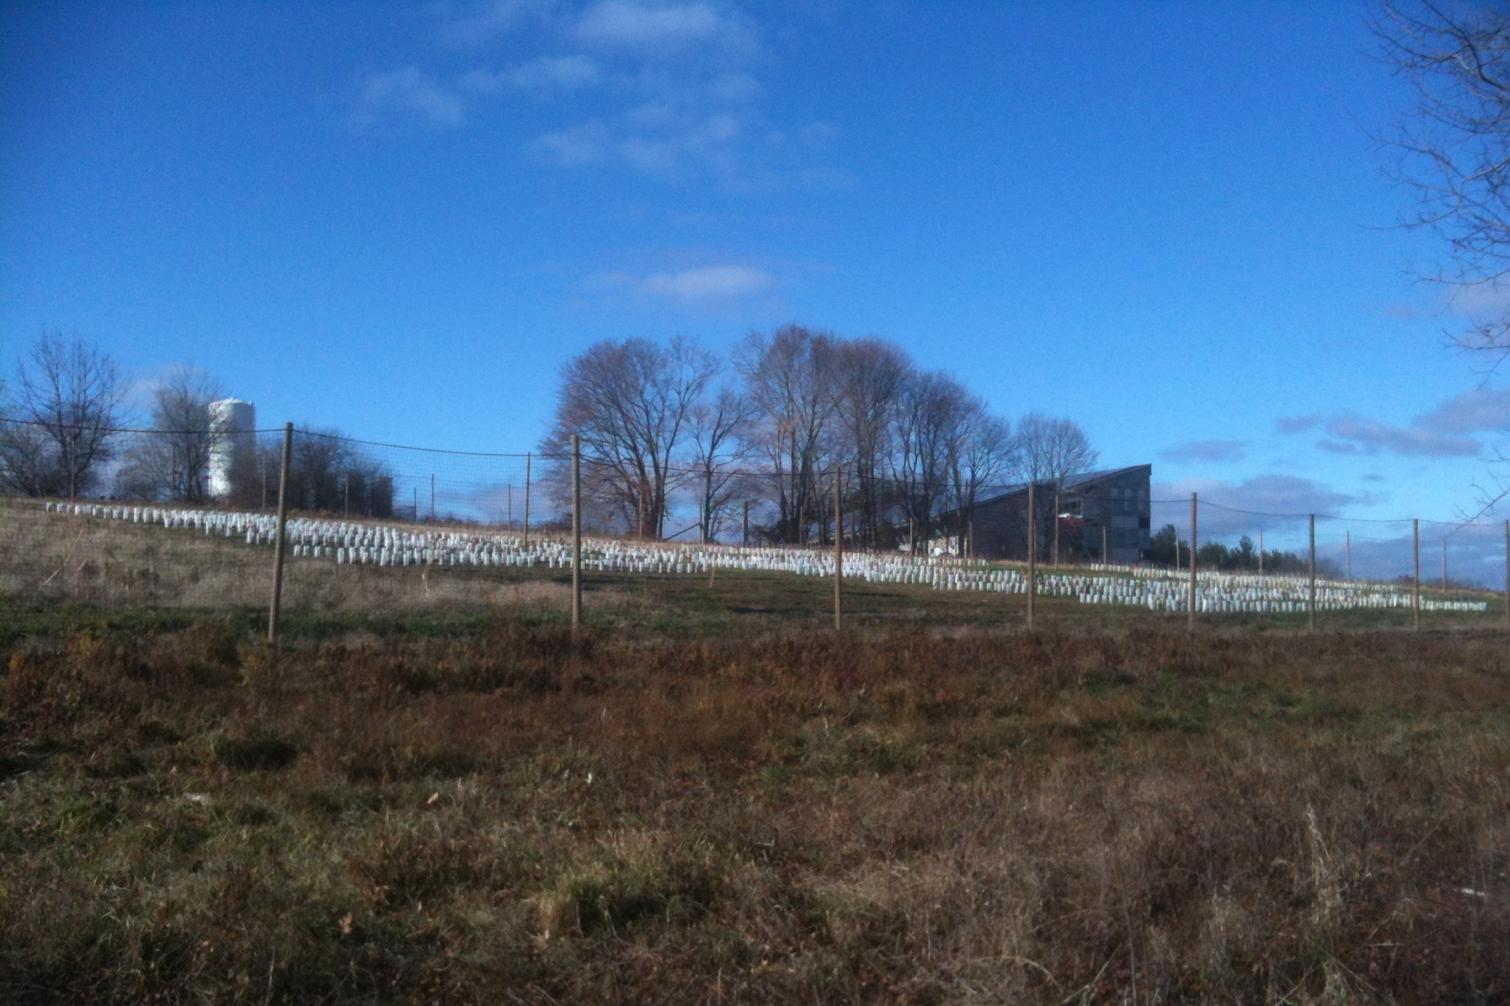
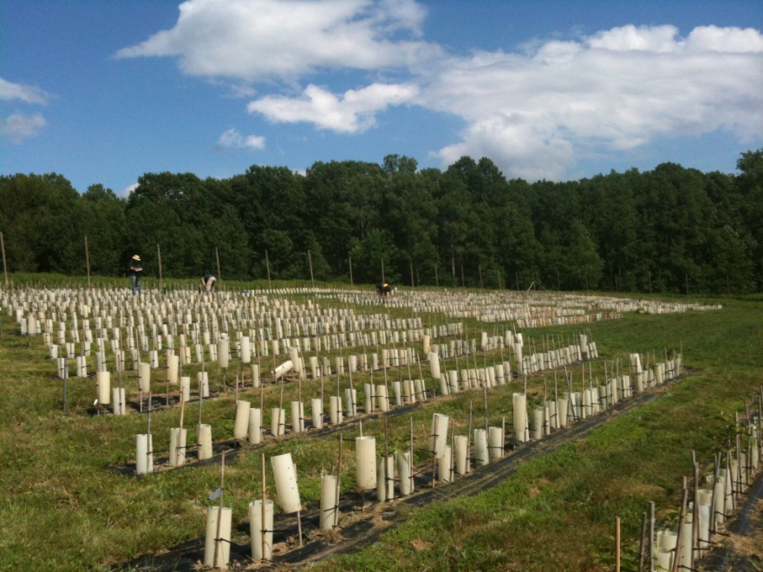

Slide 4
The American Chestnut Foundation TACF
Presentation for
Princeton Land Trust
November 16, 2016
Notes:
Now that The American Foundation has been in existence for more than 30 years, we are now aware that we have a little history ourselves, as you’ll see later on in the program.

Slide 5
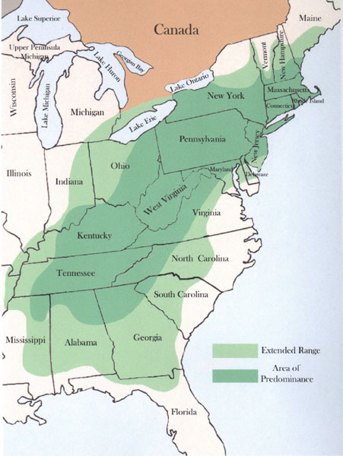
There are none still alive who remember all along the Appalachian Chain

Slide 6
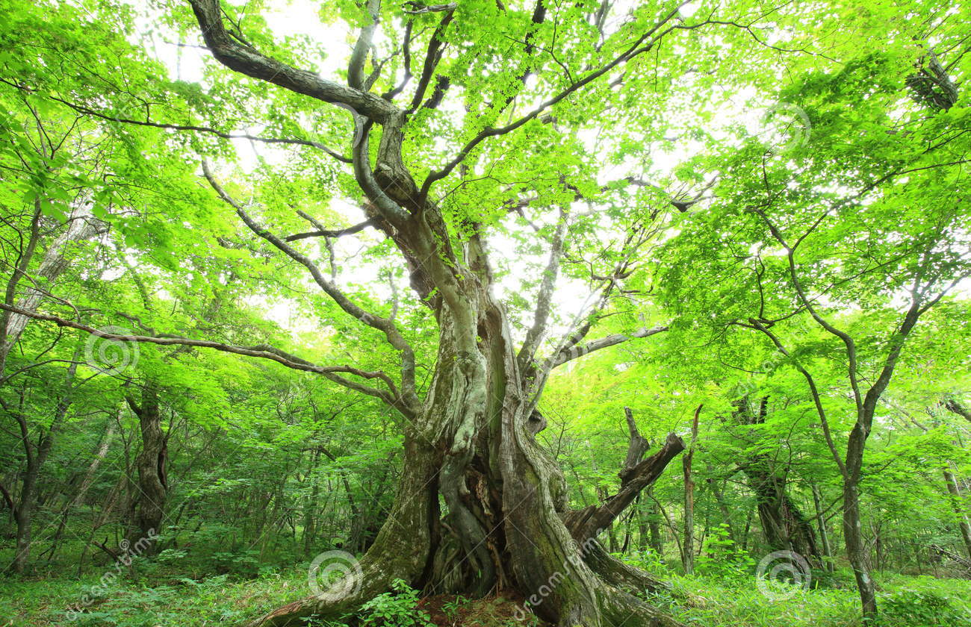
The time we ruled the woodlands, the surrounding hills and plains

Slide 7
Shawnee, Cherokee, Mohegan and Cree, we answered to their needs

Slide 8
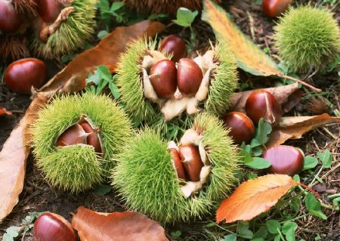
And we asked for nothing in return than to plant and dispel our seeds

Slide 9
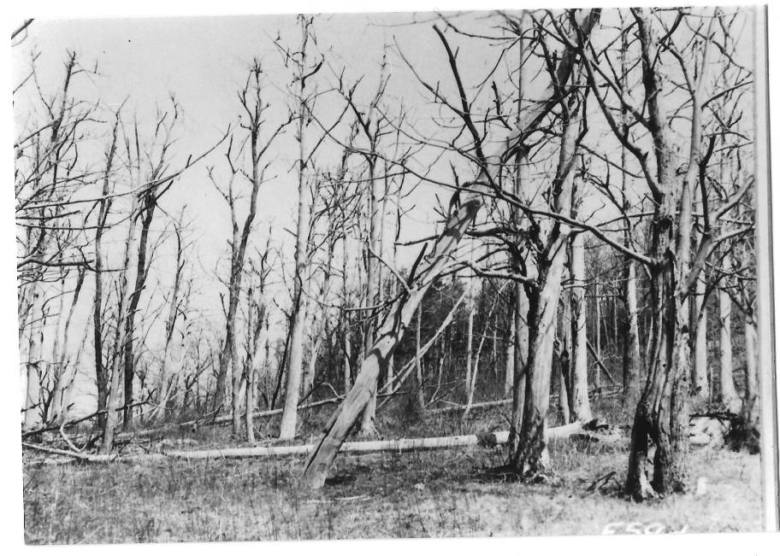
Then the plague it came among us, from across the wide empty sea

Slide 10
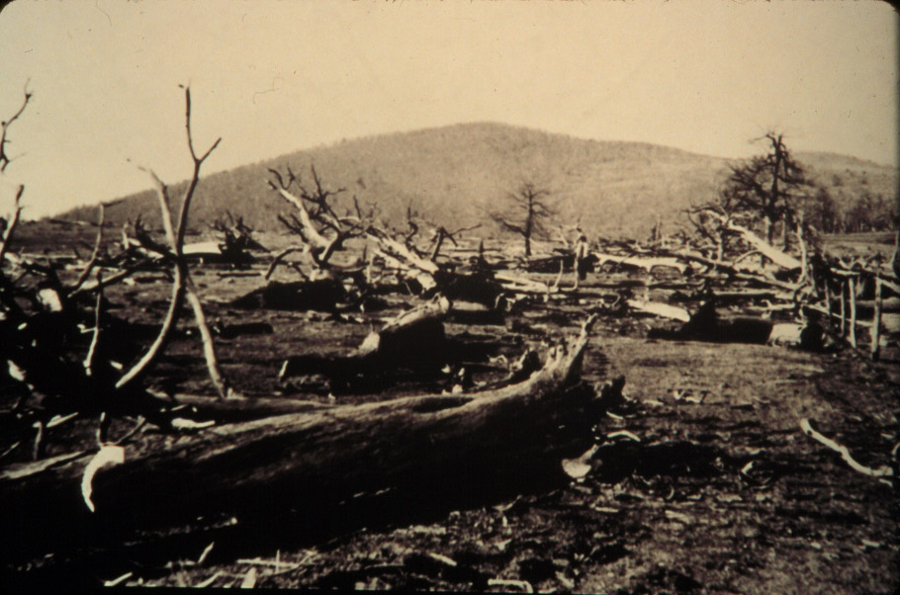
Weak and strong alike were felled, for it knew no spark of mercy

Slide 11
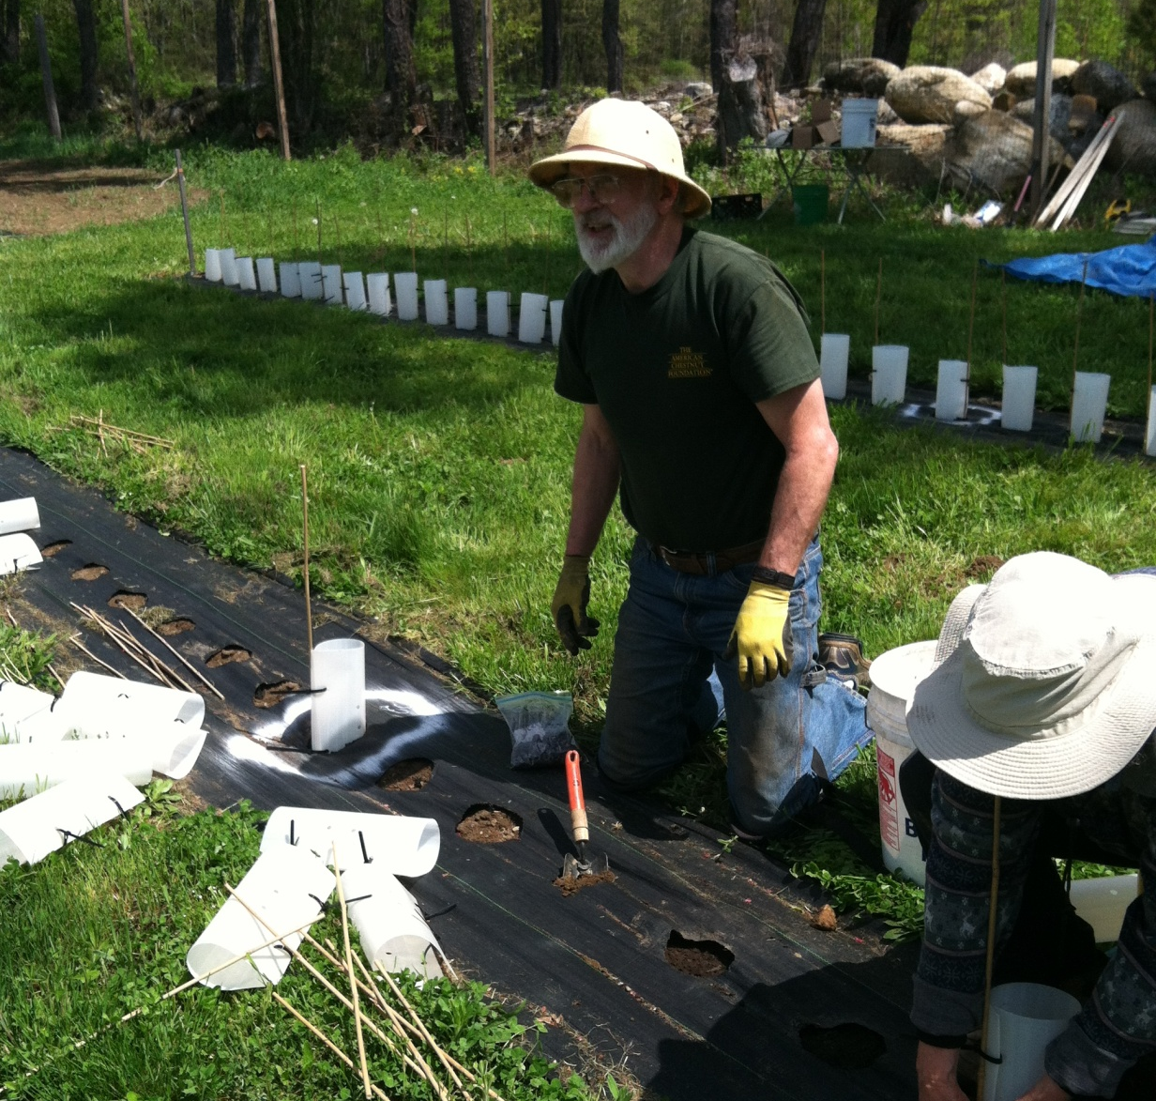
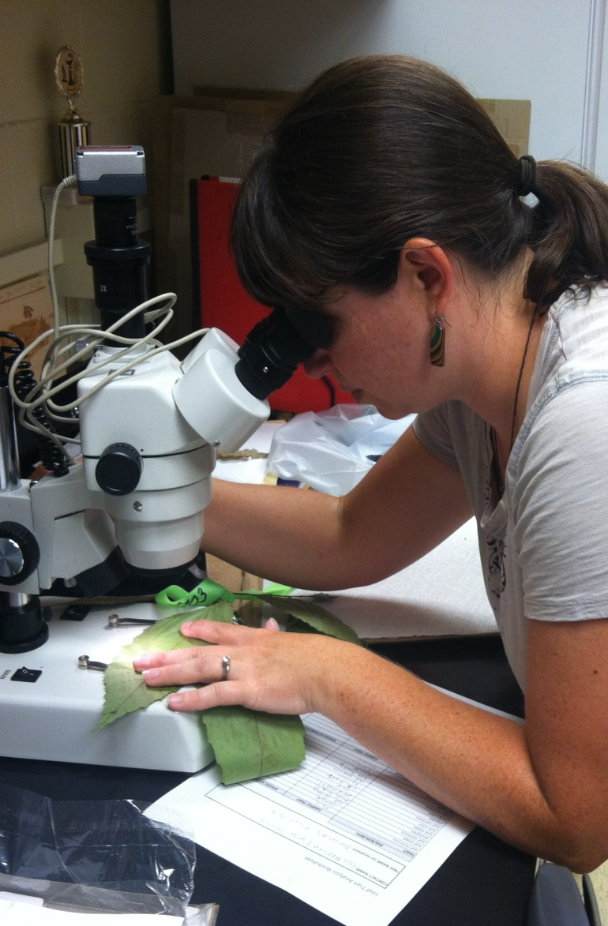
Now some say we’re gone forever, and there are so few who care

Slide 12
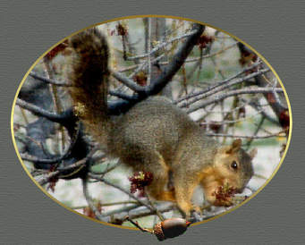
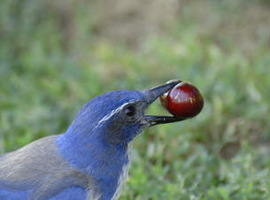
The oaks feed the few who still linger here, the squirrel, the jay and the bear

Slide 13
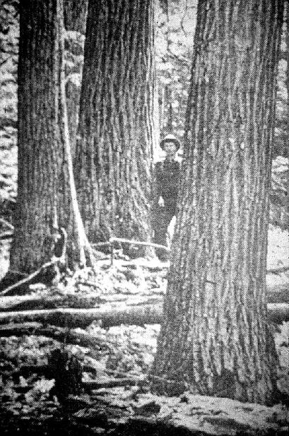
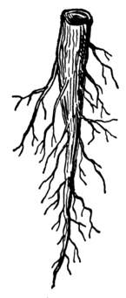
But we bide our time beneath the earth, who once were giants on the land

Slide 14
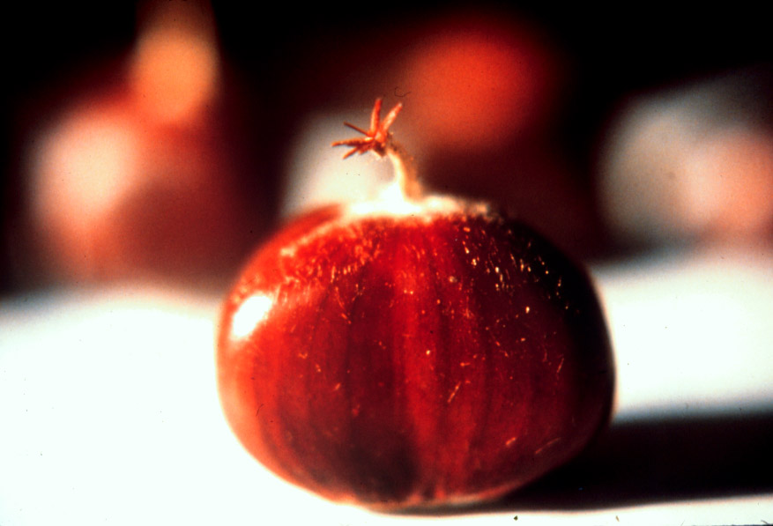
Each year we send up our silver shoots, and we will rise again

Slide 15
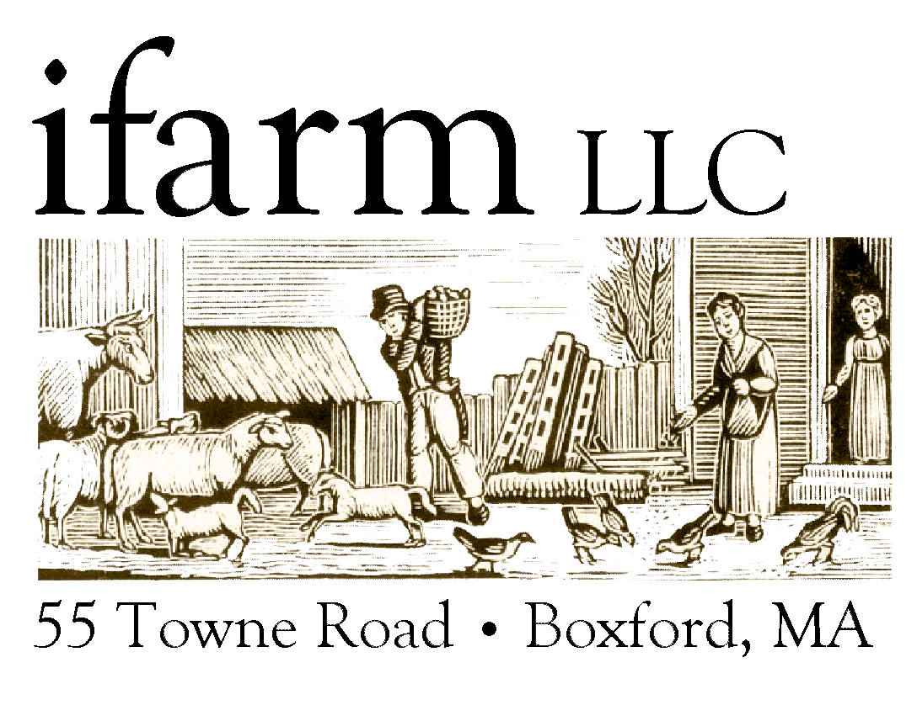
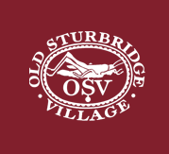
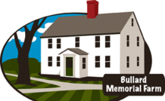
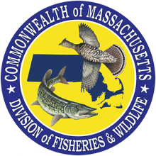
City of Pittsfield, MA
Notes:
Of course we don’t do this work alone, this is a partial list of our partners starting with Tower Hill Botanic Garden early on to the recent plantings at the Wildflower Society’s Garden in the Woods, and the Wayside Inn, and our latest community partner, the city of Pittsfield MA.
We actually have both short and long terms lists of individuals and entities that would like to partner with us in this mission. As well as communities, town cemeteries, and Land Trusts.
We do things like demonstration plantings, these are plantings of 3 – 5 trees, usually in a place with public access, and where chestnuts were once found, like Old Sturbridge Village
Of course everyone pretty much has to go through a Board of Directors review, just so that we all know what’s going on.

Slide 16
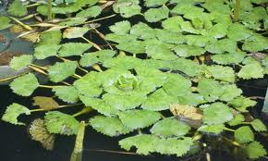
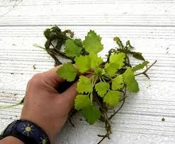
Castanea dentata – American chestnut
NOT Horse chestnut
Aesculus hippocastanum
NOT Water chestnut
Eleocharis dulcis
Notes:
Explain that C. dentata is not the same as horse chestnuts or water chestnuts, but are often confused today when people see horse chestnut trees.

Slide 17
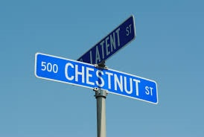
Notes:
How many towns don’t have a chestnut street, chestnut hill, or a chestnut mall?

Slide 18
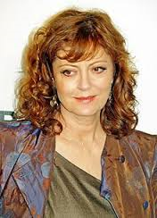
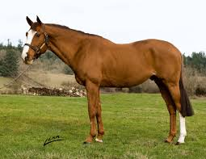
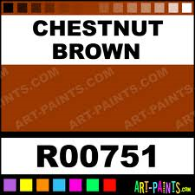
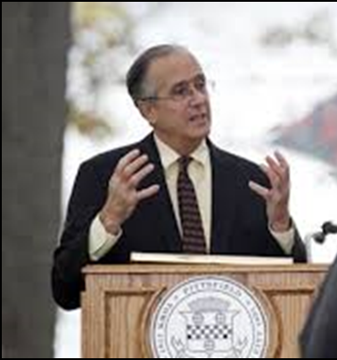
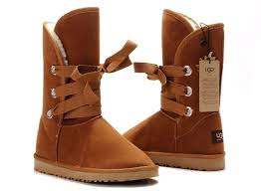
Notes:
Beyond the song, people are at least dimly aware that chestnut brown is a beautiful, natural color just as Thoreau said.

Slide 19
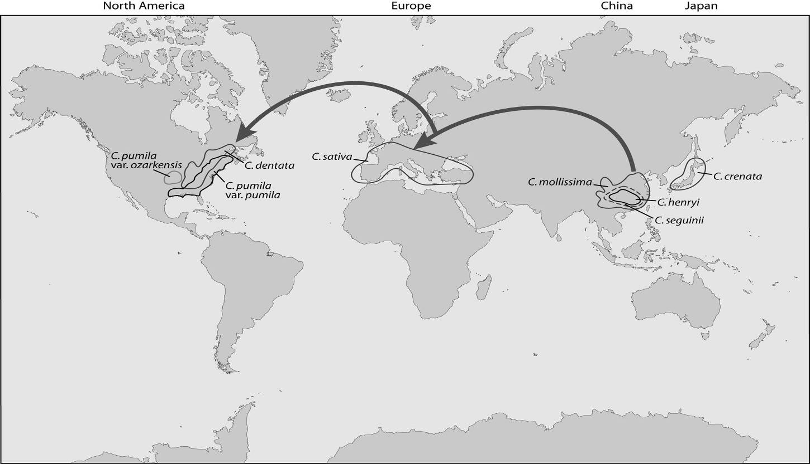
Evolutionary Migration Pathway - Castanea
American chestnut probably diverged from European chestnut some 35 - 40 million years ago
Notes:
Chestnut’s have been around for a very long time.
There 4 main varieties of chestnut, Chinese, Japanese , European and American
All but the American have some degree of blight resistant and the blight generally does not kill these trees like it does the Americans

Slide 20
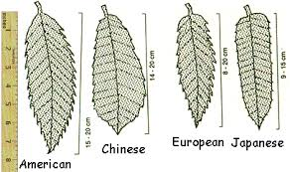
Leaf differences
Notes:
The leaves are different, the tree growth habits are different, and the sweetness and flavor of the respective nuts are also different.

Slide 22
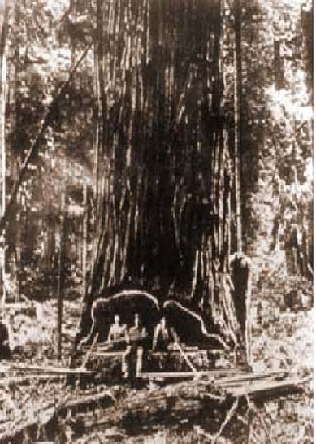
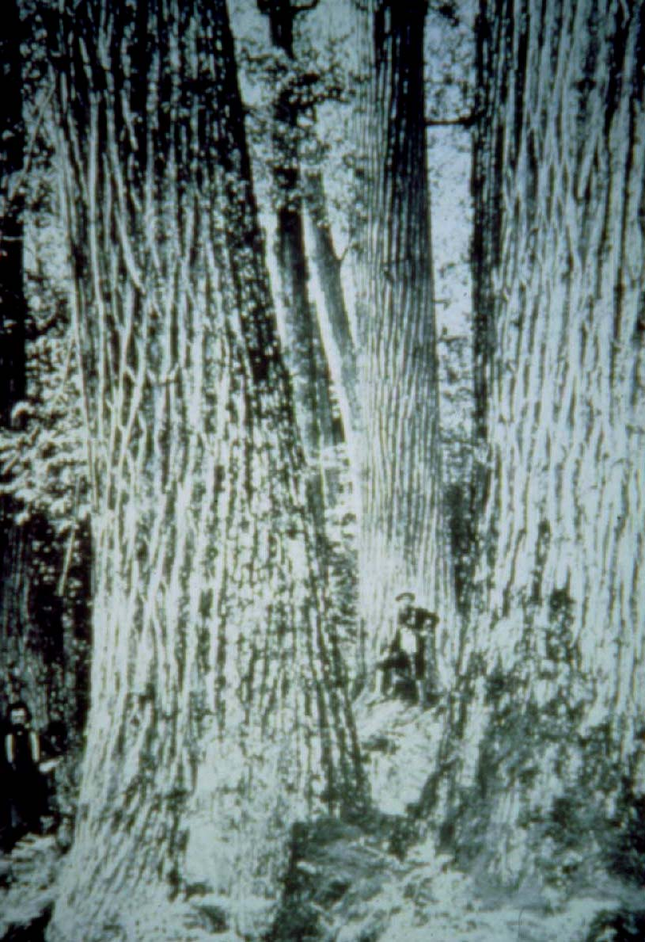
Notes:
The largest tree on record was 17 feet in diameter.
Henry David Thoreau studied chestnut trees and wrote that they grew so fast that a mature chestnut tree would be produced in 70 to 80 years

Slide 23
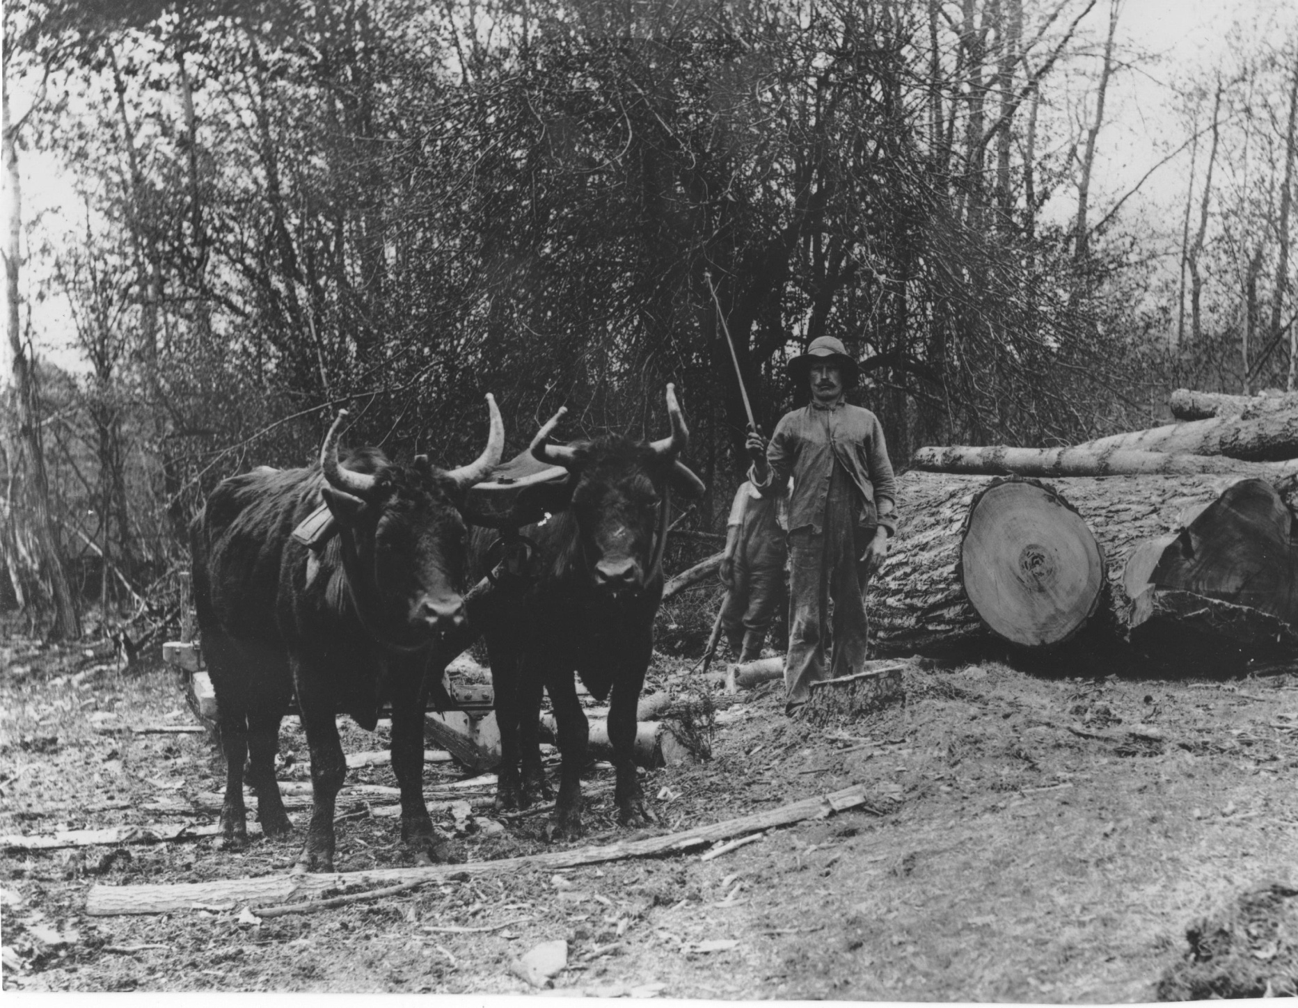

Slide 24
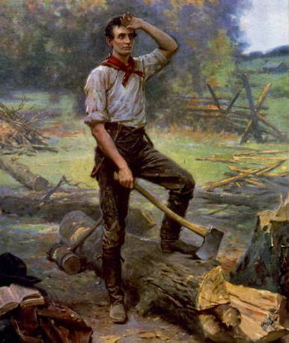
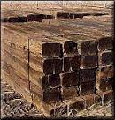
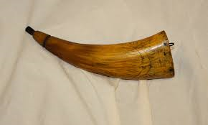
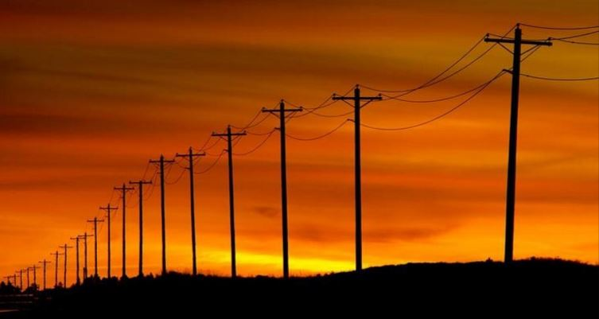

Slide 25
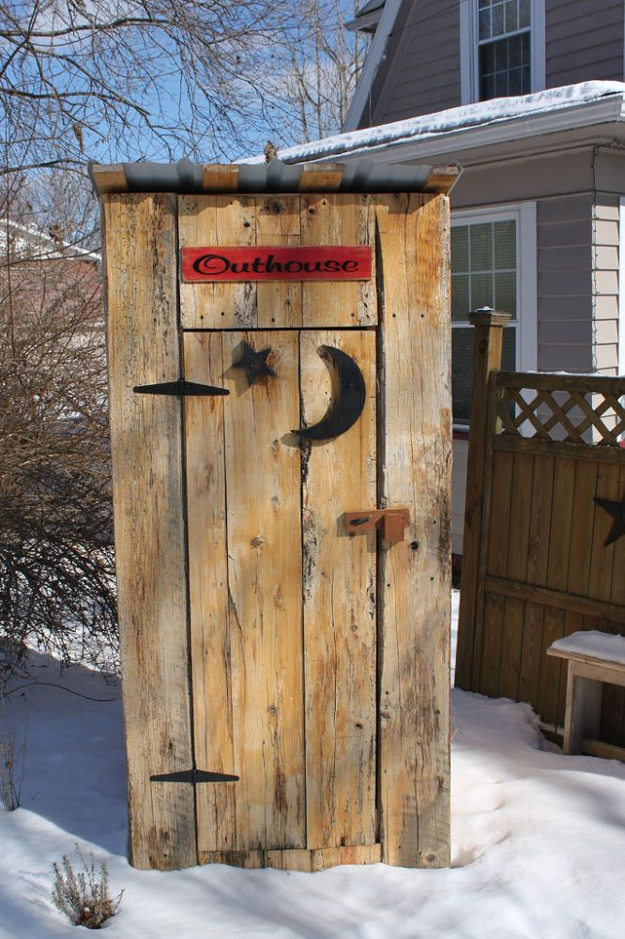
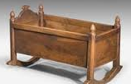
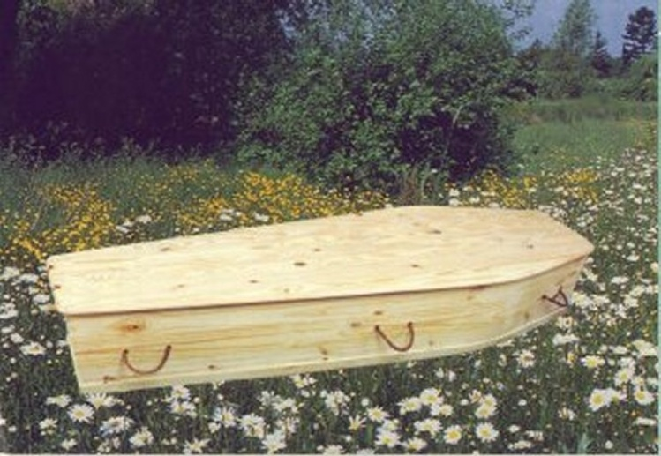

Slide 26
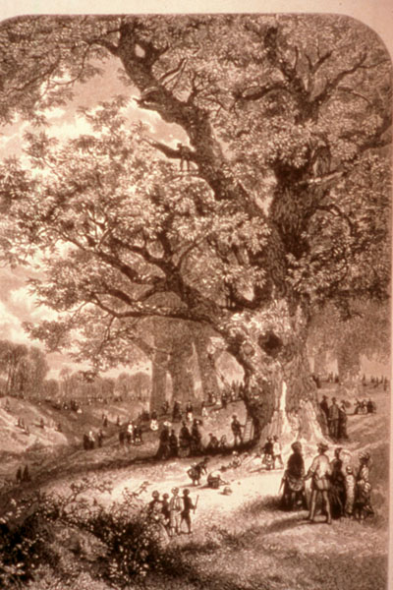
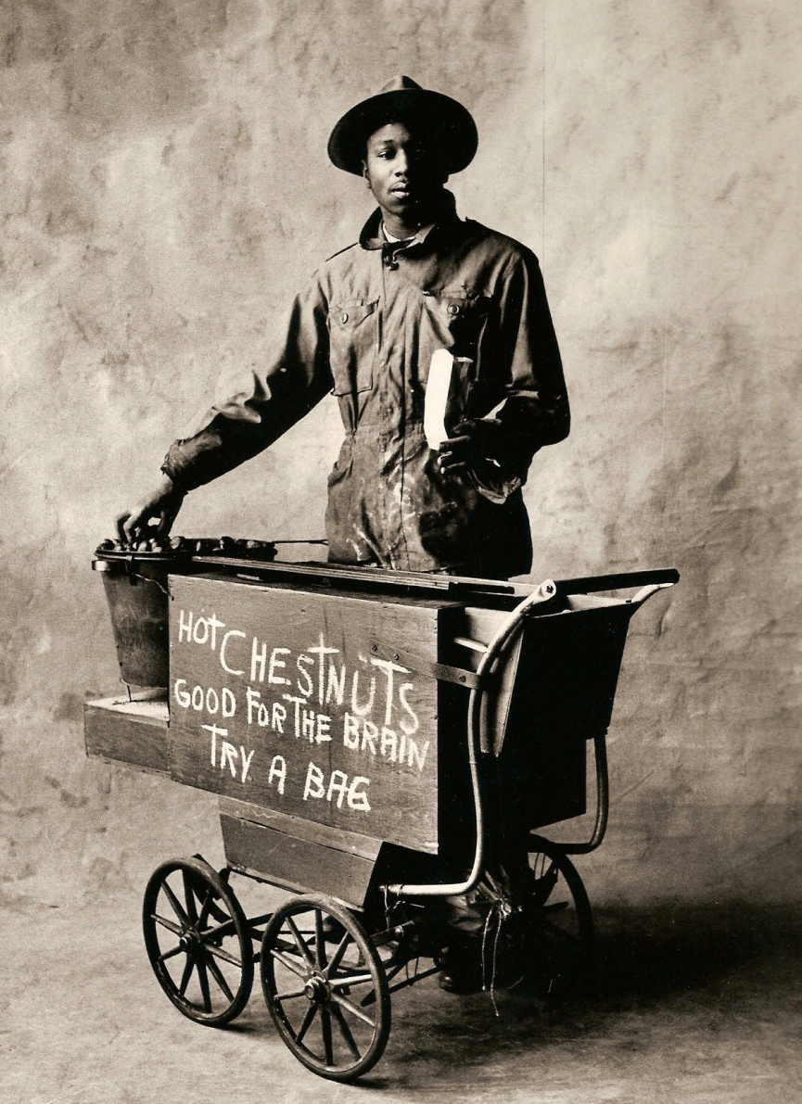

Slide 27
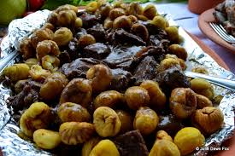
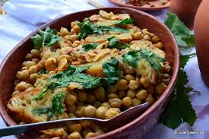
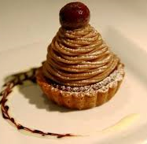
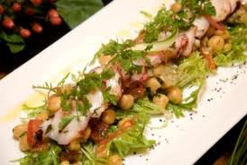
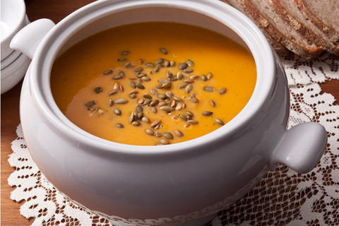

Slide 28
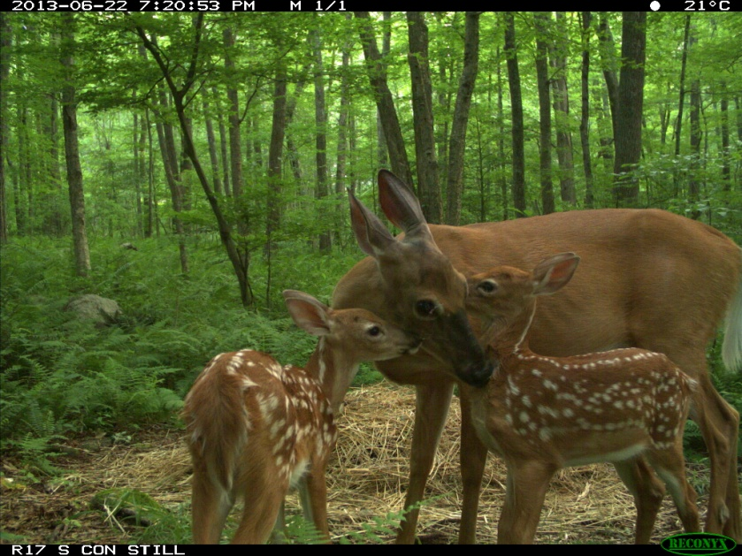
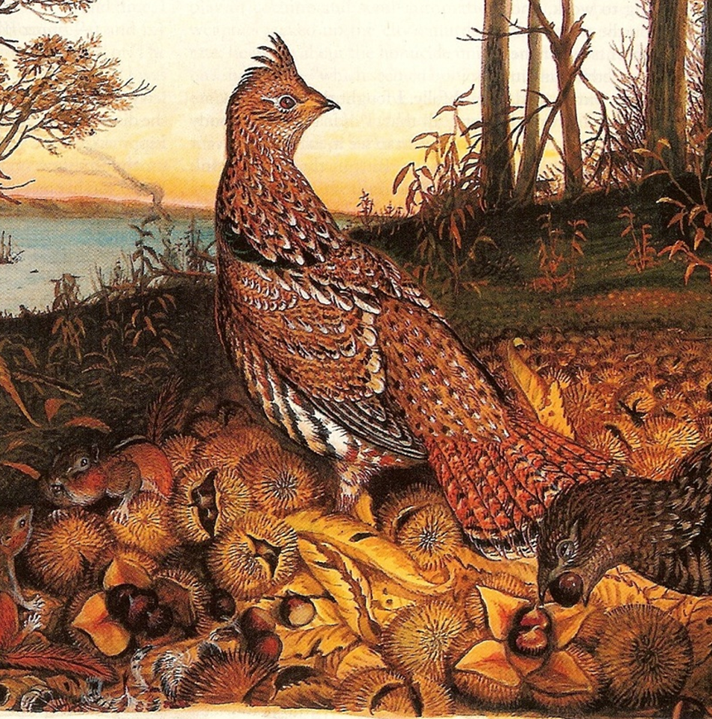

Slide 29
Wildlife Mast

Slide 30
Chestnut Blight

Slide 32
Notes:
Many places, especially in the Appalachian mountains, were left with ghost forests.
Because the disease does not affect the roots of the chestnut tree, many of these trees remained standing for a very long time, forever sending up new shoots.
Even today in the forests within the range, the sprouting stumps can still be seen today. The blight is not active in the ground, but these trees are doomed to repeat this process of sprouting, dying and resprouting and dying.
Despair was spreading just like the blight as people realized the potential damage that this bark disease would do to their beloved chestnut trees.
A few people, however had hope, from a writing of Henry Davie Thoreau
EVIL TENDENCIES CANCEL
By Robert Frost 1936
Will the blight end the chestnut?
The farmers rather guess not.
It keep smoldering at the roots
And sending up new shoots
Till another parasite shall come to end the blight.

Slide 33
Notes:
A blight ravaged, agricultural landscape

Slide 34
“All words about the chestnut are now but an elegy for it. This once mighty tree, one of the grandest features of our sylva, has gone down like a slaughtered army before a foreign fungus disease, the chestnut blight.”
Donald Culross Peattie
Notes:
Perhaps no one expressed better the sadness that Americans felt at that time about the loss of the chestnut than Donald Culross Peattie, the pre-eminent naturalist of his day and one of the most influential nature writers of the 20th century.
But still, not exactly everyone had given up…..

Slide 35
Dr. Charles Burnham
Notes:
Charles Burnham had a lifelong curiosity about what had happened to the chestnut, but he was so busy with his professional career of teaching and research, that it was not until his retirement as a university professor, that he had time to devote to chestnut research.
Essentially, they had been back crossing American chestnuts with Asian chestnuts, rather than doing backcrossing with American trees. He knew is was important to retain the tall, straight character of the American tree, while trying to incorporate the resistance of Asian trees, which grew more like fruit trees, shorter with a more horizontal branching habit.
After talking with other scientists about his hypothesis, the TACF was started.

Slide 36
TACF’s Backcross Breeding Program
Chinese
X
American
F₁ ½ American (50%)
X
American
Each generation select for:
Blight resistance
American characteristics
BC₁ ¾ American (75%)
X
American
Final Product: Breeds true with resistance equal to that of the original Chinese parent!!!
BC₂ ⁷/₈ American (88%)
X
American
BC₃ ¹⁵/₁₆ American (94%)
X
BC₃
BC₃ F₂ ¹⁵/₁₆ American (94%)
X
BC₃ F₂
BC₃ F₃ ¹⁵/₁₆ American (94%)
Notes:
This is the basic principle of Charlie Burnhams back cross breeding program, which is easily understood by looking at this chart.
Basically we cross an American with a disease resistant Chinese chestnut tree, creating a 50/50 tree.
Then we back cross to an American tree to increase the American characteristics of the tree, while checking for blight resistance and American growth characteristics at each generation.
The trees that do not exhibit good blight resistance are rogued out, leaving only those that show good blight resistance and American characteristics to go on to create the next generation.

Slide 37
Meadowview Farm
Notes:
A few years later, in 1989, a farm in Meadowview, VA was leased and the first generations of trees were put in the ground.

Slide 38
Notes:
This is Fred Hebard, who has a Master’s degree in botany and a doctorate in plant pathology, and is the chief scientist at TACF and rung Meadowview Farm in Southeast VA.
This building is the new science lab which was recently donated to the foundation.
We love Fred, and he’s as comfortable in a laboratory as he is in dungarees on a ladder in an orchard.

Slide 39
Seed Production Orchards

Slide 40
LAND’S SAKE
John Emery, Orchard Mngr. Weston MA
MASSWILDLIFE
Jamie Donald, Brad Smith Orchard Mngrs. Westboro M
MEIKLEJOHN PROPERTY
John Meiklejohn Orchard Mngr. Granville MA
SMITH COLLEGE MACLEISH FIELD STATION
Paul Wetzel, Orchard Mngr. Whately MA
SPRINGSIDE PARK
Bob Presutti, Orchard Mngr. Pittsfield MA
S. KINGSTOWN LAND TRUST
S. Kingstown Land Trust,

Slide 43
Notes:
Professor Paul Wetzel and his students are our have completely integrated the planting and ongoing care of a seed production orchard at Smith College’s Ada & Archibald MacLeish Field Station in Whately Massachusetts.

Slide 46
Meiklejohn Property

Slide 52
Become a Member!
With your help, we will return the American chestnut to its native woodlands.
Notes:
The chestnut has been gone from our society for so long, that if people are asked what comes to mind when the word chestnut is mentioned, it can be assumed that the following song will be the first thing that comes to mind.
Play The Christmas Song

Slide 56
Notes:
Quabbin Reservoir central MA
Photo by Brad Smith
In April, 1871 Science of America said
“The chestnut is one of the most beautiful of trees and deserves consideration on account of its ornamental character, a well as for its material utility.

Slide 57
From
Mighty Giants
By President Jimmy Carter, p. 14
“We are committed to doing what we can to preserve the land and restore where we can those parts that have been damaged by human use. I consider the breeding and restoration of blight-resistant chestnut trees in the United States to be one of the most interesting and important scientific projects of our time. Even more, it satisfies a spiritual longing to acknowledge our obligation to be better stewards of God’s creation.”

